Slide 1

Starting Early:
Preparing our system, employers, families, and youth with disabilities to participate in the workforce
Carolyn McDougall, Manager, Employment Pathways
Laura Bowman, Project Manager of Research and Evaluation, Employment Pathways
September 27, 2024

Slide 2


Land Acknowledgement
Acknowledgement of the land
New Climate Landscape (Northwest Coast Climate Change), Lawrence Paul Yuxweluptun, 2019

Slide 3


Acknowledgements
The Employment Pathways clinical work is generously funded by donors to Holland Bloorview Kids Rehabilitation Hospital Foundation including the Azrieli Foundation (2022-2027), the RBC Foundation in support of RBC Future Launch (2021-2026), and the Peter Gilgan Foundation (2016-2023).
Our research and evaluation work is generously funded by donors to Holland Bloorview Kids Rehabilitation Hospital Foundation including the Azrieli Foundation, as well as funding from the Government of Ontario.

Slide 4
Agenda
Introductions
Current state
“Start early”
Cases:
  Individual & Program: Employment Pathways
  Community & Business: Project SEARCH
  Public & Policy: Theoretical Modelling
Review and reflection: what is your role?

Slide 5



Introduction
Carolyn McDougall
Manager, Employment Pathways
Ontario/Canada Coordinator, Project SEARCH
Adjunct Lecturer, OS&OT, UofT
Occupational Therapist
Laura Bowman
Project Manager, Research & Evaluation
Clinical Team Investigator, Bloorview Research Institute
Adjunct Lecturer, OS&OT, UofT
Occupational Therapist
Holland Bloorview
Canada’s largest paediatric rehabilitation hospital with the vision of creating the most meaningful and healthy futures for all children, youth and families.

Slide 6




Definitions: Who?
Youth
Age 14-29
Focus on high school age
Employer
Organization, manager, or leader in a work or volunteer role
Family/Supports
Informal or formal caregiver and supporter
Society
The public interest or group
Local, provincial, national, or global
© Holland Bloorview Employment Pathways 2024

Slide 7



Definitions: What?
✔
Disability
Broad definition
Employment
Organized paid or unpaid role
A social determinant of health
Programs
Also ‘interventions’
Intended to build skills or knowledge for YwD
Services
Public or private mechanisms to serve a certain group (E.g. employment services)
© Holland Bloorview Employment Pathways 2024

Slide 8



The business case
1 in 5
Ontarians have a disability
70% of disabilities are invisible
More than 2% of Ontarians use wheelchairs or scooters
90%
Scored average/ above average for job performance
86% scored above average for attendance
97% scored average/ above average for job safety
Companies that invested in accessible employment practices report:
↑ customer satisfaction
↑ job retention
↑ attendance
↑ job performance & quality of work
↑ safety records
↓ employee turnover
© Holland Bloorview Employment Pathways 2024
https://accessibilitycanada.ca/get-help/resources/business-benefits-of-accessibility-infographic/

Slide 9
Current state of youth disability employment
 | This population | General population
Employment Rate: Canadians with disabilities ^{[1]} Canadians with severe disabilities ^{[1,2]} Canadians with very severe disabilities ^{[1,2]} | 68.8% 54.5% 29.9% | 77.8%
Employment Rate: Canadians with disabilities who have attained a high school diploma/certificate or less ^{[1]} | 45% | 68.1%
Youth Age 14-24 who are NEET Canadians with disabilities ^{[3]} Canadians with severe disabilities: employment rate ^{[3]} | 17% 28% | 11%
© Holland Bloorview Employment Pathways 2024
[1] Hebert, et al. (2024); [2] Berrigan,et al. (2020); [3] Accessibility in Canada (2024).

Slide 10

Current state of youth disability employment
Employment is a recognized social determinant of health (Raphael et al., 2020)
Early intervention (i.e., during high school) to support employment participation for people with disabilities relates to:
greater amount of time individuals access and participate in the workforce (Wehman et al. 2020; Krahn & Chow, 2016)
improved workforce attachment (Caliendo & Schmidl, 2016)
economic benefit to society (Bowman et al., 2024)
© Holland Bloorview Employment Pathways 2024

Slide 11


Best Practice
‘Start Early’

Slide 12
Best practice: What is ‘start-early’?
?
?
?
When
What
Where
High School
Self discovery Experience
Risk taking
Supported reflection
Real-world contexts
?
?
How
Who
Targeted, evidence-informed services
Equitable:
Youth, employers, society
© Holland Bloorview Employment Pathways 2024

Slide 13
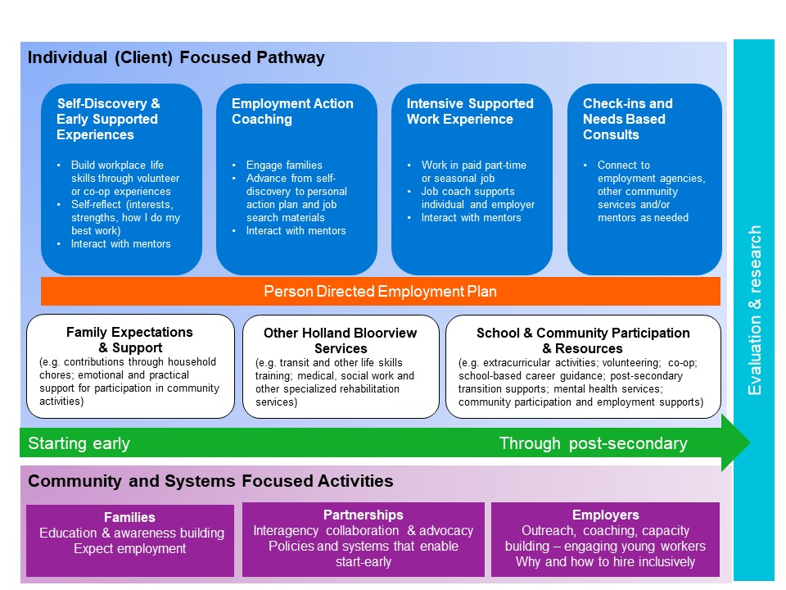
Best practice: How to ‘start-early’?
Holland Bloorview Employment Pathways Model
Bowman, L. R., McDougall, C., D’Alessandro, D., Campbell, J., & Curran, C. J. (2023). The creation and implementation of an employment participation pathway model for youth with disabilities. Disability and Rehabilitation, 45(24), 4156-4164.
Reprinted with permission of the authors.

Slide 14
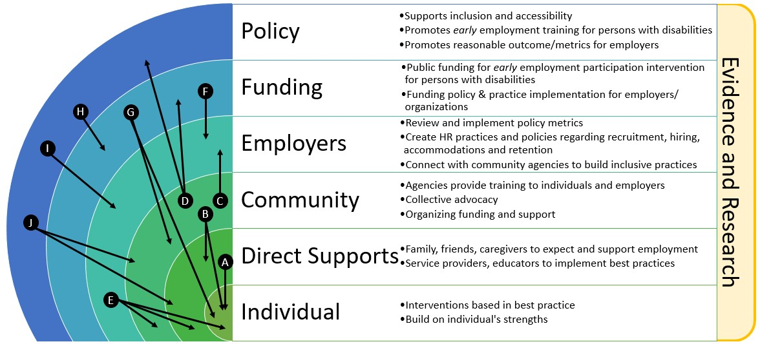
Best practice: Who must ‘start-early’?
Model of Embedded Employment Supports (MEES)
Bowman, L. R., McDougall, C., & Menna-Dack, D. (2024). A Justice Perspective on Ecologically-Based Employment Pathways for Individuals with Disabilities. In Intellectual Disabilities and Autism: Ethics and Practice (pp. 221-235). Cham: Springer International Publishing.
Reprinted with permission of the authors.

Slide 15

Cases
Cases:
Individual & Program
Community & Business
Public & Policy

Slide 16
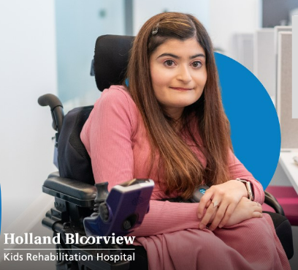
Individual and program level
Individual & program level
Holland Bloorview’s Employment Pathways Programs

Slide 17

Marya’s story

Slide 18

Holland Bloorview employment pathway

Slide 19
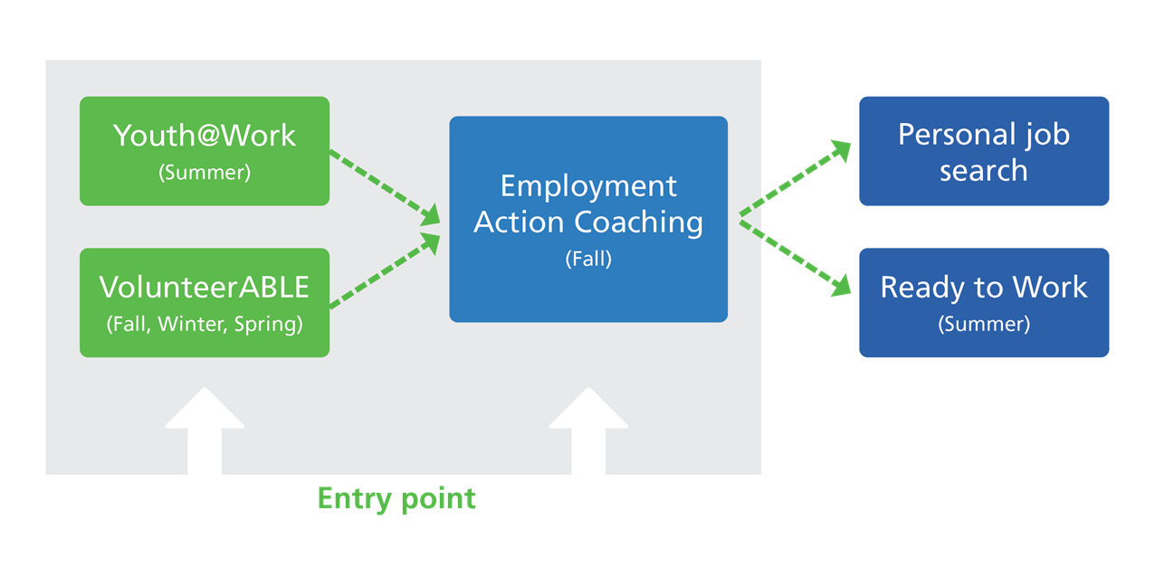
Holland Bloorview employment pathway

Slide 20
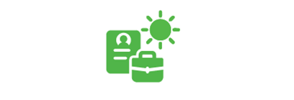
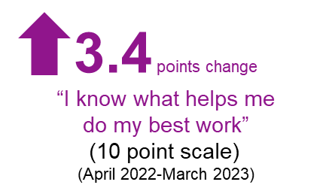
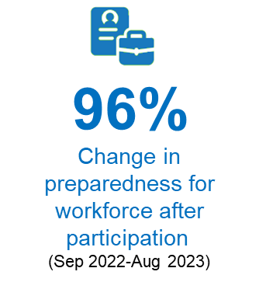
Holland Bloorview employment pathway
2.8
points change
100%
Change in preparedness for workforce after participation
(Sep 2023-Aug 2024)
100%
‘Ready to Work’ participants got paid summer job experience - average of 150 hours
(Summer 2024)
“I know what helps me do my
best work”
(10 point scale, 2=clinical significance)
(April 2023-March 2024)
© Holland Bloorview Employment Pathways 2024
*Clinical Data

Slide 21
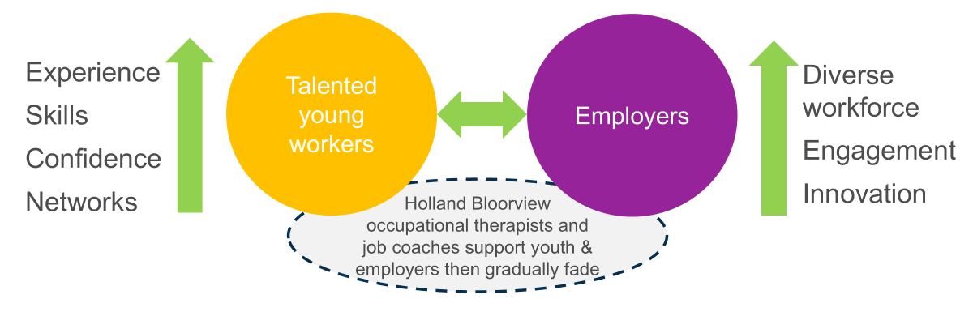
What is ‘Ready to Work’?

Slide 22
Individual and program level: takeaways
Individual & program level: Takeaways
Personalized
Progressive
Supported

Slide 23
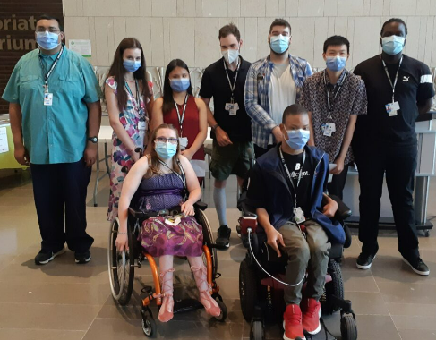
Community and business level
Community & business level
Project SEARCH

Slide 24

Mackenzie’s story

Slide 25

Those farthest from employment

Slide 26



Project SEARCH: international model
FINAL YEAR OF HIGH SCHOOL ⇒ WORK
10-month training program
Host business
Education partner
Employment agency partner
Experiences
700+ hours, 3 training “internships” immersed at host business
Transition to employment support
Community employment agency provides coaching & consultation employment support for graduate & employer
70% + employment rate of graduates in community
+
=
Job coaching
On the job progressive skills training
Employability & life skills training
Evidence-informed curriculum
Student-focused employment & future planning. Community connections Student | Engaged family | Partners
Wehman et al., (2020)

Slide 27
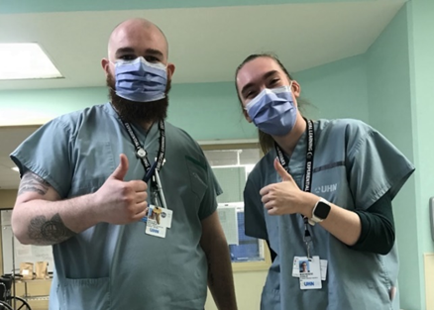
Mackenzie’s training for employment
As she started the Project SEARCH program, Mackenzie knew she liked helping people.
She learns well through repetition as her intellectual disability affects her reading and writing skills.
She progressively built marketable skills across 3 internships.
Internship 1: Hospital Daycare
Internship 2: Hospital School
Internship 3: Hospital Patient Transport
Paid Work: Hospital Patient Transport
Job coaching
Mentorship
Early employment skills
Reflection
Job coaching
Mentorship
Early employment skills
Reflection
Generalization
Job coaching
Mentorship
Reflection
Generalization
Employment Supports
Average of 25 hours/week
Part of a union
Earns above min wage
In hospital pension plan
© Holland Bloorview Employment Pathways 2024

Slide 28

Braided, sustainable expertise & funding needed
Youth with significant disabilities left behind in current system - inter-sectorial/agency expertise key to success
X
Current state
Education system
Employment support system
Developmental disability system
Employment outcome?
Education system
Braided expertise & funding needed for success
✔
Employment support system
Developmental disability system
Wehman et al., (2020)

Slide 29


Resolve sustainability issues to expand access & impact
Transforming lives
Income
Social inclusion
Health & wellbeing
Building disability confidence & inclusive workplaces
Diverse workplace
Unique skills
Reduced labour market shortages
Societal cost benefit
Decrease individual lifetime social assistance costs and increase income tax
Diverse and inclusive labour force
© Holland Bloorview Employment Pathways 2024

Slide 30
Community and business level: takeaways
Community & business level: Takeaways
Collaborative
Shared responsibility
Pipelines

Slide 31

Public and policy level
Public & policy level
Theoretical
cost-benefit modelling
Paper:
https://www.frontiersin.org/journals/sociology/articles/10.3389/fsoc.2024.1281088/full
Report:
Forthcoming
(October 1, 2024)

Slide 32

Theoretical cost-benefit modelling
🚫 fund programs without data
🚫 get program data without funds

Slide 33
Theoretical cost-benefit modelling
$
Theoretical Data
To promote public funding of stable, equitable "start early" programs, we created a cost-benefit model to show lifetime government return on investment.
🚫 fund programs without data
🚫 get program data without funds

Slide 34
Theoretical cost-benefit modelling
Baseline
Global inputs
Local context inputs
Persona inputs
Intervention/Program
Intervention/Program +
© Holland Bloorview Employment Pathways 2024

Slide 35
Theoretical cost-benefit modelling
High School to Work
Age: 20
Disability: Intellectual disability + Autism
Challenges: limited work experience, social communication skills, literacy, time management
Start-Early Program: Project SEARCH
Public investment: $16,000
© Holland Bloorview Employment Pathways 2024

Slide 36
Theoretical cost-benefit modelling
High School to Work
Age: 20
Disability: Intellectual disability + Autism
Challenges: limited work experience, social communication skills, literacy, time management
Start-Early Program: Project SEARCH
Public investment: $16,000
Reduced lifetime government spending of 696% ($127,338) per individual
© Holland Bloorview Employment Pathways 2024

Slide 37
Theoretical cost-benefit modelling
University to Work
Age: 16
Disability: Cerebral Palsy; mild learning disability
Challenges: difficulty standing/walking for long periods, carrying heavy items, confidence
Start-Early Program: Holland Bloorview’s Employment Pathways
Public investment: $16,752
© Holland Bloorview Employment Pathways 2024

Slide 38
Theoretical cost-benefit modelling
University to Work
Age: 16
Disability: Cerebral Palsy; mild learning disability
Challenges: difficulty standing/walking for long periods, carrying heavy items, confidence
Start-Early Program: Holland Bloorview’s Employment Pathways
Public investment: $16,752
Increased lifetime government realized cost savings of 755% ($143,215) per individual
© Holland Bloorview Employment Pathways 2024

Slide 39

Theoretical cost-benefit modelling
Total lifetime cash flow to government
by annual cohort of 100 students*
An annual public investment of $1,600,000 would yield lifetime return of
$8,913,694
per cohort of high school persona students.
An annual public investment of $1,675,200 would yield lifetime return of
$10,025,047
per cohort of university persona students.
© Holland Bloorview Employment Pathways 2024
*Assuming that after investing in all 100 students, only 70% obtain the desired outcomes

Slide 40


Theoretical cost-benefit modelling
Our modelling shows that with a small public investment per person ($16-17,000)
Government would realize a 600% return ($127,000+) per person
With this information, we can:
Advocate for public funding for start-early employment programming.
Increase availability of evidence-based start-early programming for people who have a disability in Ontario.
© Holland Bloorview Employment Pathways 2024

Slide 41
Public and policy level: takeaways
Public & policy level: Takeaways
Equitable
Sustainable
Responsible
Pipeline

Slide 42
Back to starting early
?
?
?
When
What
Where
High School
Self discovery Experience
Risk taking
Supported reflection
Generalize to next steps
Real-world contexts
?
?
How
Who
Targeted, evidence-informed services
Equitable:
Youth, employers, society
© Holland Bloorview Employment Pathways 2024

Slide 43
3 things we can do right now
Learn about unique barriers to employment facing in-school youth with disabilities
Work with youth, families and community organizations to develop local solutions
Advocate for public policy & funding for enable to early employment experience programming across Canada

Slide 44

Thank you!
Thank you!
Laura Bowman lbowman@hollandbloorview.ca
Carolyn McDougall cmcdougall@hollandbloorview.ca

Slide 45
References
Accessibility in Canada: Results from the 2022 Canadian Survey on Disability (2024-05-28). Retrieved from https://www150.statcan.gc.ca/n1/daily-quotidien/240528/dq240528b-eng.htm
Berrigan, P., Scott, C. W., & Zwicker, J. D. (2020). Employment, education, and income for Canadians with developmental disability: analysis from the 2017 Canadian survey on disability. Journal of Autism and Developmental Disorders, 53, 580-592. https://doi.org/10.1007/s10803-020-04603-3
Bowman, L. R., McDougall, C., D’Alessandro, D., Campbell, J., & Curran, C. J. (2023). The creation and implementation of an employment participation pathway model for youth with disabilities. Disability and Rehabilitation, 45(24), 4156-4164.
Bowman, L. R., McDougall, C., Doucet, R., Pooran, B., Xu, Y., & Campbell, J. (2024). Funding employment inclusion for Ontario youth with disabilities: a theoretical cost-benefit model. Frontiers in Sociology, 9, 1281088.
Bowman, L. R., McDougall, C., & Menna-Dack, D. (2024). A Justice Perspective on Ecologically-Based Employment Pathways for Individuals with Disabilities. In Intellectual Disabilities and Autism: Ethics and Practice (pp. 221-235). Cham: Springer International Publishing.
Hebert, B-P., Kevins, C., Mofidi, A., Morris, S., Simionescu, D., & Thicke, M. (2024). Reports on Disability and Accessibility in Canada. A demographic, employment and income profile of persons with disabilities aged 15 years and over in Canada, 2022. Retrieved from https://www150.statcan.gc.ca/n1/pub/89-654-x/89-654-x2024001-eng.htm
Wehman, P., Schall, C., McDonough, J., Sima, A., Brooke, A., Ham, W., ... & Riehle, E. (2020). Competitive employment for transition-aged youth with significant impact from autism: A multi-site randomized clinical trial. Journal of autism and developmental disorders, 50, 1882-1897.

