Slide 1




The Win-Win of Designing Workplaces for Disability Inclusion
IDEA Symposium, October 6 & 7, 2025
vraie-idea.ca
vraie-idea.ca

Slide 2
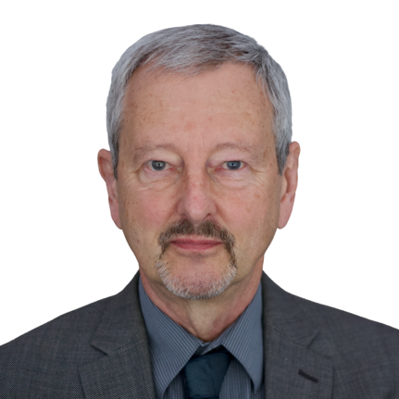

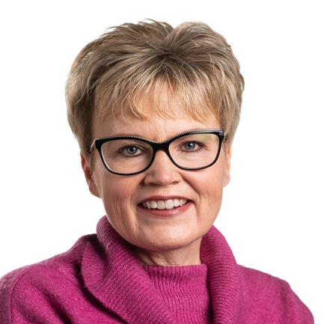
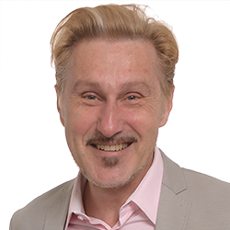
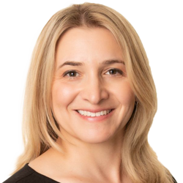
Welcoming Remarks
Alec Farquhar, IDEA Strategic Advisor; Former Director, Office of the Worker Adviser
Sinead McCarthy, Vice President, Development, Programs and HR, Youth Employment Services; IDEA Hub Co-lead for Transitions to Work and Career Development
Krista Carr, Chair, IDEA Advisory Committee; CEO, Inclusion Canada
Emile Tompa, Executive Director, IDEA; Department of Economics, McMaster
Rebecca Gewurtz, Director, IDEA; School of Rehabilitation Science, McMaster

Slide 3
Opening Comments about IDEA & Symposium
vraie-idea.ca

Slide 4

Disability Employment Awareness Month

Slide 5
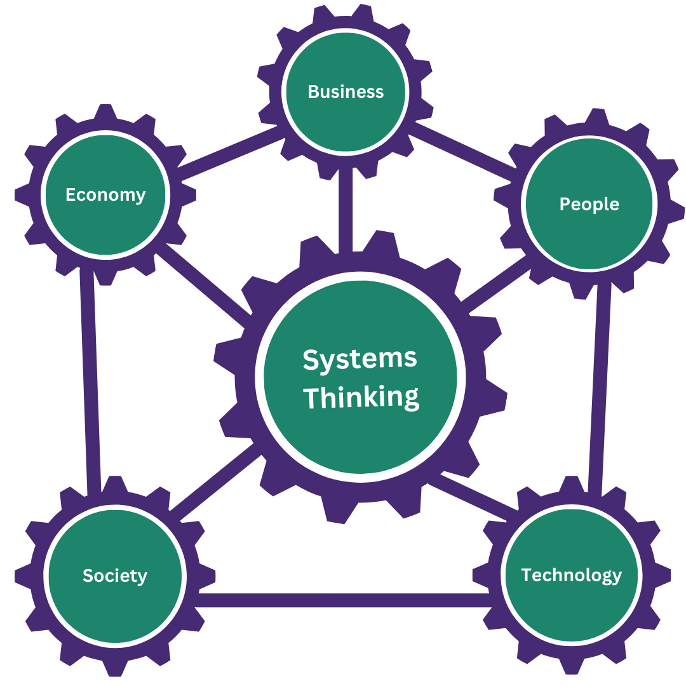
Overview of IDEA’s Approach
Demand-side capacity + Systems-level approach = Transformational change
Our mission is to help create stronger and more diverse labour markets that include persons with disabilities by developing, evaluating and sharing evidence-informed knowledge-to-practice solutions.
Annual benefits of inclusion for Canada
Total benefits: $338 Billion (17.6% of GDP in 2017)
Labour-market benefits: $62.2 Billion (3.2% of GDP in 2017)

Slide 6

“Nothing Without Us”
Persons with disabilities fully and directly participate in all IDEA activities as:
Co-design Partners
Project Advisors
Key Informants
Researchers and Trainees
Staff Members
Champions

Slide 7
Disability Communities
Autism Alliance of Canada
Autism Society of Newfoundland and Labrador
Burnaby Association for Community Inclusion
Canadian Association for Supported Employment / MentorAbility
Canadian Hard of Hearing Association
Gateway Association
Inclusion Canada / Ready, Willing and Able
Inclusions East
Indigenous Disability Canada
Level It Up
LiveWorkPlay
March of Dimes Canada
Ontario Disability Employment Network
Realize
Spinal Cord Injury Manitoba Inc
Trailblazers Life Choices

Slide 8
Labour, Industry & Services
Labour
Canadian Labour Congress
National Union of Public and General Employees
United Food and Commercial Workers Canada
Industry and Services
Access to Success
Baer Engineering and Environmental Consulting Inc
BDO Canada
Bell Canada
Better Belonging
Canadian Council on Rehabilitation and Work
Canadian Standards Association
Career Foundation
CBC
CBI Consultants
Coco Creative
Community Living Essex Country / RealXChange
Community Living Toronto
Enabled Talent
Enbridge
Family Support Network for Employment
Gowan Consulting
Human Resources Professionals Association
Hub International
Inclusion Africa

Slide 9
Labour, Industry & Services (cont’d)
Inclusive Kind
INNoVA
Interior Health
Jazz Aviation
Lifemark
Ontario Network of Injured Workers Groups
Ontario School Safety
Mentor Canada
NCCO Rehabilitation Services
Niewe Consulting Ltd.
Nthusa Consulting Group
Partners in Canadian Veterans Rehabilitation Services
Performance Plus Rehabilitative Care Inc.
Prepr
Royal Bank of Canada
St. Joseph’s Healthcare
Telus
The Low Achiever
Times Change
Tiree
Tomee Sojourner Consulting Inc.
Tourism HR
Vista Hill Foundation
VPI Employment Services
WCG International
Workplace Safety and Insurance Board
Youth Employment Services / WorkAbility

Slide 10
Government
Accessibility Standards Canada
Agriculture et Agroalimentaire Canada
Canada Border Services Agency
City of Guelph
City of Sarnia
Employment and Social Development Canada
Government of British Columbia
Government of Manitoba
Government of New Brunswick
Government of Nova Scotia
Government of Ontario
Interior Health
Ministry for Seniors and Accessibility
Ministry of the Attorney General
Municipality of Cumberland County
Ontario Health at Home
Natural Resources Canada
Public Services and Procurement Canada
Tennessee Department of Transportation
Treasury Board of Canada Secretariat
Veterans Affairs Canada
York Region

Slide 11
Academics and Research
Acadia University
Addis Ababa University
Atlantic Provinces Special Education Authority
Business + Higher Education Roundtable
Carleton University
Cestar College
Cornell University / Yang-Tan Institute on Employment and Disability
Emily Carr University
Giant Steps Montreal
Halton District School Board
Holland Bloorview Kids Rehabilitation Hospital
Institute for Work & Health
Lehigh University
McMaster University
OCAD University
Ontario Tech University
Queen’s University
Royal Roads University
San Diego State University
Toronto Metropolitan University / Diversity Institute
UHN KITE Research Institute
University of British Columbia
University at Buffalo
University of Guelph
University of Melbourne
University of Michigan
University of Modena and Reggio Emilia
Université du Québec à Montréal
Université du Québec en Outaouais
Université du Québec à Trois-Rivières
University of Toronto
University of Victoria
University of Winnipeg
York University

Slide 12
Land Acknowledgement
We would like to start by acknowledging that the land on which we are gathered is the traditional territory of many nations including the Mississaugas of the Credit, the Anishinaabe, the Chippewa, the Haudenosaunee, and the Wendat peoples, and is now home to many diverse First Nations, Inuit, and Métis peoples. This land is covered by Treaty 13 and the Williams Treaties.
We recognize the enduring presence and deep traditional knowledge of Indigenous peoples with respect to this land. As we come together today, we do so with respect and gratitude, and with a commitment to the ongoing process of truth and reconciliation. This includes acknowledging the harms of colonialism, listening to Indigenous voices, and working collectively toward equity, justice, and meaningful change.

Slide 13
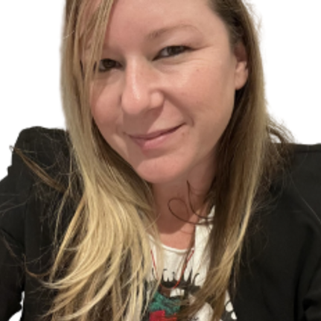
Morning Remarks
Melissa (Missy) Fishman , Educator and Community Collaborator, 2-Spirited People of the 1st Nations

Slide 14
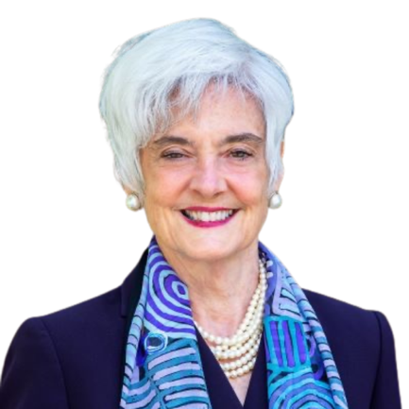
Opening Keynote
Susanne Bruyere, Academic Director, Yang-Tan Institute on Employment and Disability, Cornell University

Slide 15


Implementation of Inclusive Employment Practices as Tools to Support Employer Journeys
Inclusive Design for Employment Access (IDEA)
October 6, 2025
Susanne M. Bruyere, Ph.D., CRC
Professor of Disability Studies and Academic Director
Cornell University, Ithaca, NY, USA

Slide 16


About the Institute
The Yang-Tan Institute works to advance the inclusion and full participation of people with disabilities in the workplace and community. Our work in research, training, and technical support expands knowledge about disability inclusion, leading to positive change.
Cornell University overlooking Cayuga Lake in the fall, from the air.
Notes:
© Cornell University, 301 College Ave, Ithaca, NY 14853; 607-255-7675; photo@cornell.edu.

Slide 17
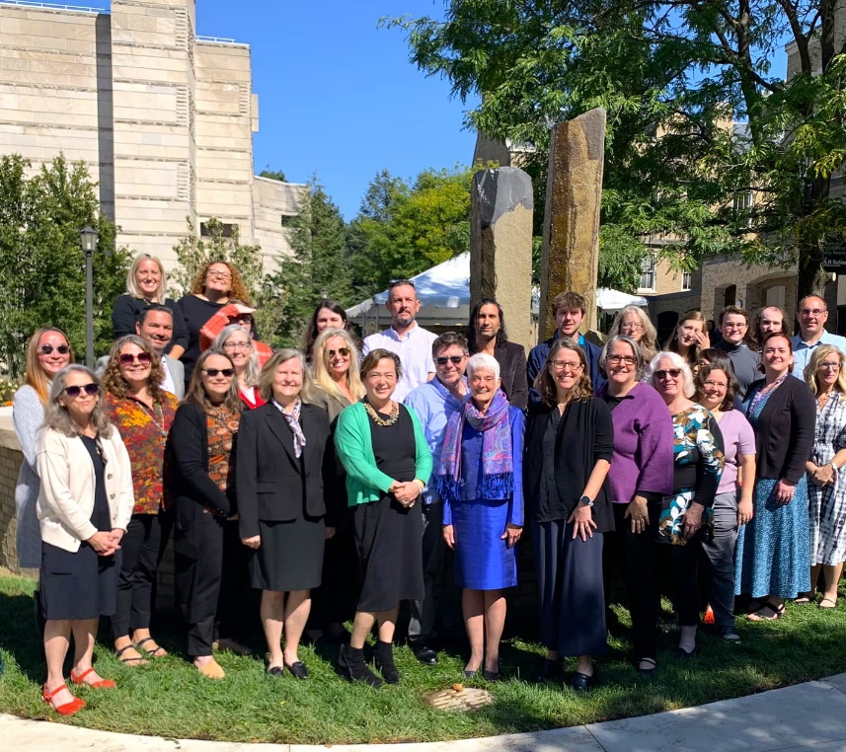
Yang-Tan Institute on Employment and Disability
Conduct research and knowledge translation/diffusion activities
Focus on maximizing full inclusion of people with disabilities in employment and civil society
62-member multi-disciplinary team
Enterprise unit
© 2025 Cornell University, ILR School, Yang-Tan Institute on Employment and Disability

Slide 18

Who Are Our Target Audiences?
People with disabilities
Family members of people with disabilities
Disability service and advocacy organizations
Policy makers
Government agencies
Employers, unions
Schools at all levels
Communities

Slide 19
Goal of Today’s Presentation
Provide a broad overview of the elements of workplace policies and practices that contribute to success in improving employment outcomes for individuals with disabilities
Based on Cornell’s research and that of others
Share related resources
Recognize that this is an ever-evolving landscape
Engage with others on this very important journey
© 2025 Cornell University, ILR School, Yang-Tan Institute on Employment and Disability

Slide 20
Elements of Effective Change
The Person Integration Independence Inclusion
Public policy supporting inclusion
Public and private employment supports
Corporate/ employer engagement
Community and family supports
Educational preparation, work experience, and higher education
Adapted from Bruyère, S. & Barrington, L. (2012). Employment and work. Los Angeles, CA: Sage Reference.
© 2025 Cornell University, ILR School, Yang-Tan Institute on Employment and Disability

Slide 21
Corporate/Employer Engagement
Elements of Effective Change
Readying the workplace
Building the talent pipeline and onboarding
Accessibility and accommodation
Workplace climate and the supervisor role
Retaining and advancing talent
Engaging internal and external supports
Scaling and sustainability
© 2025 Cornell University, ILR School, Yang-Tan Institute on Employment and Disability

Slide 22
Elements of Effective Change (1)
Readying the workplace
Building the talent pipeline and onboarding
Accessibility and accommodation
Workplace climate and supervisor role
Retaining and advancing talent
Engaging internal and external supports
Scaling and sustainability
© 2025 Cornell University, ILR School, Yang-Tan Institute on Employment and Disability

Slide 23
Readying the Workplace
Enlist top management support
Infuse into the strategic business goals of the organization
Articulate specific goals for desired outcomes
Identify specific targeted areas where talent is needed
Identify geographic and departmental locations where there are available jobs
Engage internal champions and willing supervisor participants
Erickson, W. A., von Schrader, S., Bruyère, S. M., VanLooy, S. A., & Matteson, D. S. (2014). Disability-inclusive employer practices and hiring of individuals with disabilities. Rehabilitation Research, Policy, and Education, 28(4), 309–327. doi: http://dx.doi.org/10.1891/2168-6653.28.4.309
© 2025 Cornell University, ILR School, Yang-Tan Institute on Employment and Disability

Slide 24
Elements of Effective Change (2)
Readying the workplace
Building the talent pipeline and onboarding
Accessibility and accommodation
Workplace climate and supervisor role
Retaining and advancing talent
Engaging internal and external supports
Scaling and sustainability
© 2025 Cornell University, ILR School, Yang-Tan Institute on Employment and Disability

Slide 25
Building the Talent Pipeline
Assure top management support
Tap existing hiring networks (universities, colleges, etc.)
Tap internal resources (ERGs, CSR networks, etc.)
Work with local community disability employment organizations sourcing desired talent
Create a disability-inviting and accessible website
Develop internships to include people with disabilities
Inform and educate recruiters and hiring managers
Review and retool the interview process, if needed
Design a disability supportive onboarding process
Erickson, W. A., von Schrader, S., Bruyère, S. M., VanLooy, S. A., & Matteson, D. S. (2014). Disability-inclusive employer practices and hiring of individuals with disabilities. Rehabilitation Research, Policy, and Education, 28(4), 309–327. doi: http://dx.doi.org/10.1891/2168-6653.28.4.309
© 2025 Cornell University, ILR School, Yang-Tan Institute on Employment and Disability

Slide 26
Effective Hiring Activities
Targeted internships: 5.7 times
Strong senior management commitment: 4.8 times
Explicit organizational hiring goals: 4.1 times
Active recruitment, screening, interviewing: 3.2 times
Including in diversity and inclusion plan: 3.2 times
Relationships with community orgs: 2.7 times
Erickson, W. A., von Schrader, S., Bruyère, S. M., VanLooy, S. A., & Matteson, D. S. (2014). Disability-inclusive employer practices and hiring of individuals with disabilities. Rehabilitation Research, Policy, and Education, 28(4), 309–328. doi:10.1891/2168-6653.28.4.309
© 2025 Cornell University, ILR School, Yang-Tan Institute on Employment and Disability

Slide 27
Best Practices for Company Websites and Career Pages
Evidence of top management commitment
Statement of CEO
Disability inclusion a part of business strategy
Publicizing the “business case” for disability hiring
Having a targeted disability hiring goal and demonstrably measuring progress toward that goal
Disability hiring practices evident on career pages
Messaging that encourages rather than dissuades applicants with disabilities to apply
Robust D&I statements that include disability
Employee testimonials and job previews
Using trained recruiters rather than just AI filters
Saleh, M. (2020) Online Recruitment of and Outreach to People with Disabilities: Literature Review. Washington, DC: U.S. Department of Labor, Office of Disability Employment Policy, Employer Assistance Resource Network.
© 2025 Cornell University, ILR School, Yang-Tan Institute on Employment and Disability

Slide 28
Rethinking the Interview Process
Employer strategies for more inclusive practice:
Strategic organizational focus and disability awareness training for HR and hiring professionals prior to interviews
Modifying or replacing existing interview protocols
Examples of possible interview protocol changes might include:
Providing interview questions to community partner or interviewee in advance
Eliminate “open-ended” and “vague” (hypothetical) interview questions
Introduce applicants to the work environment prior to starting the interview as an “ice breaker”
Consider replacing interview panels with shorter, 1:1 or 2:1 interview settings
Avoid “rapid-fire” questioning strategies
Allow opportunities to show technical skills by solving a specific, work-relevant problem (“skills-based” interview process)
Chang, H-Y, Saleh, M., Bruyere, S., & Vogus, T. (2023). Making the employment interview work for a neurodiverse workforce: Perspectives of individuals on the Autism Spectrum, employers, and service providers. Journal of Vocational Rehabilitation, 59, 107-122. DOI:10.3233/JVR-230031
© 2025 Cornell University, ILR School, Yang-Tan Institute on Employment and Disability

Slide 29
Elements of Effective Change (3)
Readying the workplace
Building the talent pipeline and onboarding
Accessibility and accommodation
Workplace climate and supervisor role
Retaining and advancing talent
Engaging internal and external supports
Scaling and sustainability
© 2025 Cornell University, ILR School, Yang-Tan Institute on Employment and Disability

Slide 30
Accessibility and Accommodation
Accessibility should start with universal and inclusive design
Build for use for the greatest number of people
May eliminate or lessen the need for accommodation requests
Includes physical, sensory, information and technology accessibility
“Inclusive design” – designing in collaboration with intended stakeholders
Include emergency planning strategy
Accommodation process
Have a designated office or person to address accommodation questions
Provide training for supervisors about process and accommodations
Coach supervisors about the importance of having an “interactive dialogue”
Have a centralized accommodation fund
Regularly check with the individual about the effectiveness
Include policies and practices around flexible leaves and hybrid work
Erickson, W. A., von Schrader, S., Bruyère, S. M., & VanLooy, S. A. (2013). The employment environment: Employer perspectives, policies, and practices regarding the employment of persons with disabilities. Rehabilitation Counseling Bulletin, 57(4), 195–208. doi:10.1177/0034355213509841
© 2025 Cornell University, ILR School, Yang-Tan Institute on Employment and Disability

Slide 31
Elements of Effective Change (4)
Readying the workplace
Building the talent pipeline and onboarding
Accessibility and accommodation
Workplace climate and supervisor role
Retaining and advancing talent
Refining internal and external supports
Scaling and sustainability
© 2025 Cornell University, ILR School, Yang-Tan Institute on Employment and Disability

Slide 32
Organizational Factors Contributing to a Climate of Workplace Disability Support
Strategic mindset (most relevant for promoting a sense of belonging)
Recognize people with disabilities as resourceful, creative thinkers (in part because of challenges they’ve overcome from living with a disability)
Demonstrate salient commitment
Visible senior management commitment
Dedicated staff for disability issues
Corporate support of programs for individuals with disabilities, within & outside company (e.g., ERGs)
Mention of disability in core values/diversity mission
Leverage internal and external partnerships
Preparing supervisors for their role
Preparing internal resources to contribute workplace disability support as needed
Engaging external resources to further contribute to workplace disability support
Erickson, W. A., von Schrader, S., Bruyère, S. M., & VanLooy, S. A. (2013). The employment environment: Employer perspectives, policies, and practices regarding the employment of persons with disabilities. Rehabilitation Counseling Bulletin, 57(4), 195–208. doi:10.1177/0034355213509841
© 2025 Cornell University, ILR School, Yang-Tan Institute on Employment and Disability

Slide 33
Employee or Business Resource, Colleague Network Groups
Most effective when senior management lends support
Can assist with candidate recruitment, identifying supervisors, willing mentors/buddies, etc.
Help to identify barriers/issues; assist with finding solutions
Support for families or newly–diagnosed individuals
Can bring significant business value when product development and marketing assigned (e.g., focus groups for design issues)
Partner/network with other colleague network groups
© 2025 Cornell University, ILR School, Yang-Tan Institute on Employment and Disability

Slide 34
Using Internal Resources: Importance of Communications
A company's communications, marketing, and branding departments can contribute to workplace disability supports by assisting with –
Program brand-building
Leveraging company intranet
General internal awareness
Messaging
Program spotlighting
Event planning; use naturally-occurring celebrations (UN International Day of Persons with Disabilities, Dec. 3; UN Autism Awareness Day, April 2)
© 2025 Cornell University, ILR School, Yang-Tan Institute on Employment and Disability

Slide 35
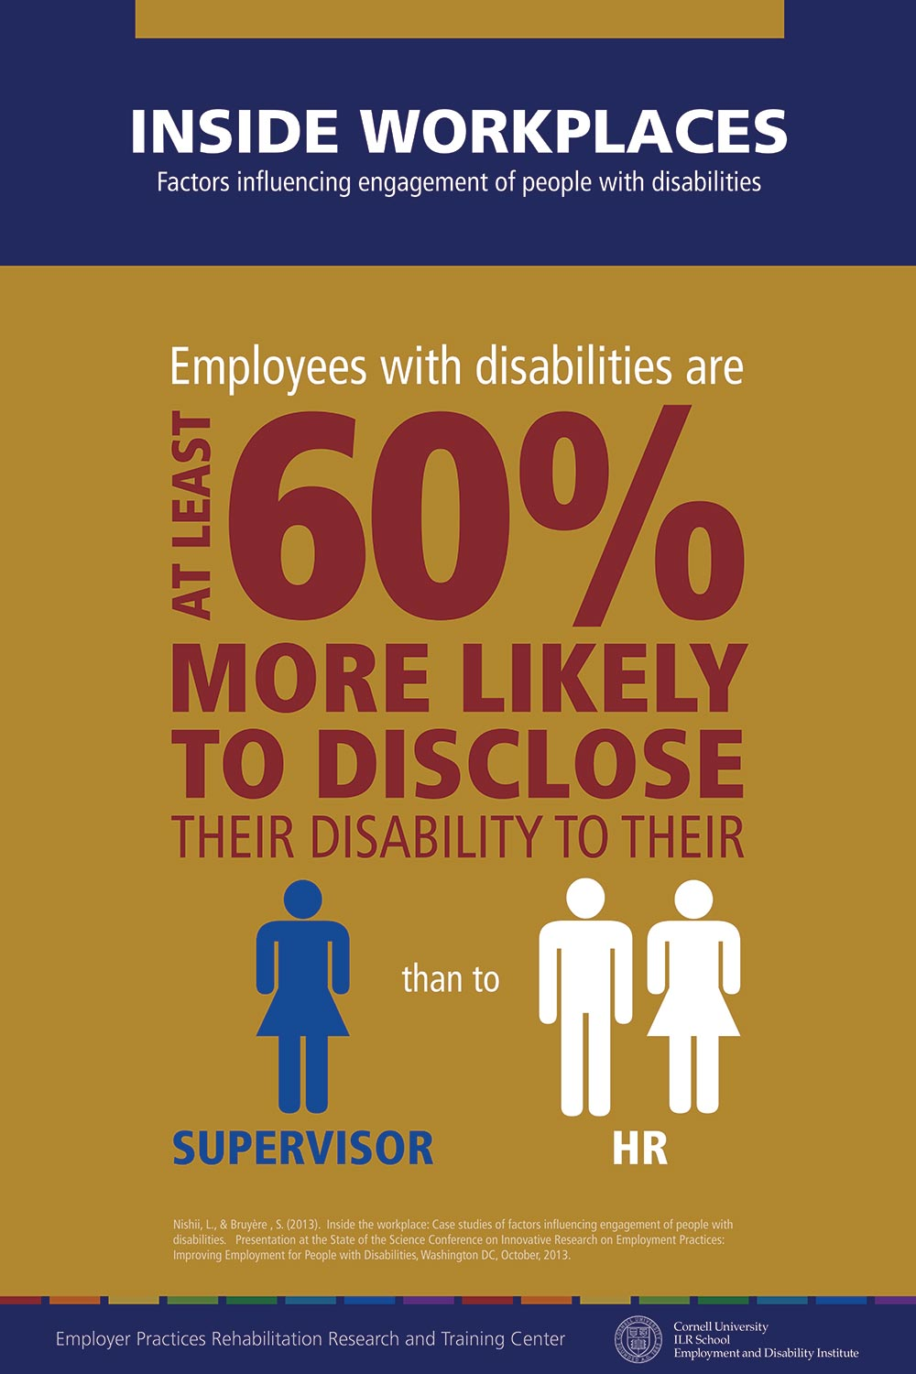
Disability disclosure facilitates accommodation access
Supervisors must be prepared to respond in a way that facilitates disclosure and assists in the identification of the accommodation that will maximize initial or continued access to the workplace, productivity, and job success.
Nishii, L., & Bruyère , S. (2014). Inside the workplace: Case studies of factors influencing engagement of people with disabilities. Research Brief. Ithaca, NY: Cornell University

Slide 36
Managers’ Role is Critical
Disability disclosure most often occurs with the manager or co-workers, rather than with HR; education and training around disability disclosure is vital to foster supportive workplace culture
Managers are key to the quality of workplace experiences of people with disabilities
Manager perceptions of organizational motivation for disability support (true interests rather than legal compliance) positively impacts disability climate
Nishii, L., & Bruyère , S. (2014). Inside the workplace: Case studies of factors influencing engagement of people with disabilities. Research Brief. Ithaca, NY: Cornell University Employment and Disability Institute.
© 2025 Cornell University, ILR School, Yang-Tan Institute on Employment and Disability

Slide 37
Elements of Effective Change (5)
Readying the workplace
Building the talent pipeline and onboarding
Accessibility and accommodation
Workplace climate and supervisor role
Retaining and advancing talent
Engaging internal and external supports
Scaling and sustainability
© 2025 Cornell University, ILR School, Yang-Tan Institute on Employment and Disability

Slide 38
Retaining and Advancing Talent
Training of supervisors on coaching, mentoring, performance appraisal of employees with disabilities
Provide regular and consistent performance feedback
Provide regular re-evaluation of accommodations
Offer mentoring, coaching, training, project work and stretch assignments, facilitating group/team project opportunities
Track organizational metrics on compensation, professional development, advancement, and retention to assure equal opportunities
Provide effective return-to-work and disability case management
Erickson, W. von Schrader, S. Bruyère, S. & VanLooy, S. (2013)The Employment Environment: Employer Perspectives, Policies, and Practices Regarding the Employment of Persons with Disabilities. Rehabilitation Counseling Bulletin http://rcb.sagepub.com/content/early/2013/11/14/0034355213509841.full.pdf
© 2025 Cornell University, ILR School, Yang-Tan Institute on Employment and Disability

Slide 39
Elements of Effective Change (6)
Readying the workplace
Building the talent pipeline and onboarding
Accessibility and accommodation
Workplace climate and supervisor role
Retaining and advancing talent
Engaging internal and external supports
Scaling and sustainability
© 2025 Cornell University, ILR School, Yang-Tan Institute on Employment and Disability

Slide 40
Engaging Internal Resources
Top management support
Human resources, employee and labor relations, benefits offices
Supervisors and recruiters
Employee Assistance Program (EAP)
Employee resource/business, colleague network groups
Health, safety, ergonomics
Facilities
Procurement services
© 2025 Cornell University, ILR School, Yang-Tan Institute on Employment and Disability

Slide 41
Engaging External Resources
National federal and state/provincial vocational rehabilitation service delivery systems
Public-private apprenticeships/internships
Community employment service providers
Customized employment
Supported employment
Medical and mental health clinical services
Centers for independent living
Transportation
Housing
© 2025 Cornell University, ILR School, Yang-Tan Institute on Employment and Disability

Slide 42
Elements of Effective Change (7)
Readying the workplace
Building the talent pipeline and onboarding
Accessibility and accommodation
Workplace climate and supervisor role
Retaining and advancing talent
Engaging internal and external supports
Scaling and sustainability
© 2025 Cornell University, ILR School, Yang-Tan Institute on Employment and Disability

Slide 43
Scaling and Sustainability
Assess initiative strengths, successes, weaknesses, failures
Keep metrics across each stage of the employment process
Replicate the process of identifying -
Organizational talent needs (new positions, new skills, turnover, etc.)
Leadership champions and willing supervisors
Availability of internal supports
Ready talent pipelines (community employment referral organizations, universities, colleges, vocational training programs, family associations)
Community support systems (transportation, housing, clinical, etc.)
Build a culture of sustainability
Build top leadership support
Imbed policies and practices into existing systems
© 2025 Cornell University, ILR School, Yang-Tan Institute on Employment and Disability

Slide 44
In Closing
Individuals with disabilities are one in five of us
Our workforce, workplace, and society will be immeasurably advantaged by having their full participation
There are known workforce development and workplace policies and practices that better assure we achieve the goals we are focusing on here today
Recognize that this is an ever-evolving landscape
Working together across all interests in forums such as this now and into the future will make this a reality
© 2025 Cornell University, ILR School, Yang-Tan Institute on Employment and Disability

Slide 45
Related Online Resources
BenchmarkABILITY® – www.BenchmarkABILITY.org
Disability Outreach Messaging Checklist – https://askearn.org/publication/disability-outreach-messaging-checklist
Employer Assistance and Resources Network on Disability (EARN) -
https://askearn.org/
Job Accommodation Network (JAN) - https://askjan.org/
Neurodiversity in the Workplace Resources -
https://askearn.org/page/neurodiversity-resources
Small Business Toolkit –
https://askearn.org/page/small-business-toolkit
Workplace Accommodation and Accessibility Policy: A Disability Employment Toolkit -
https://askearn.org/page/accommodation-and-accessibility-toolkit
Workplace Mental Health Toolkit –
https://askearn.org/page/mental-health-toolkit
© 2025 Cornell University, ILR School, Yang-Tan Institute on Employment and Disability

Slide 46
Select Related References (1) (2012-2023)
Chang, H-Y, Saleh, M., Bruyere, S., & Vogus, T. (2023). Making the employment interview work for a neurodiverse workforce: Perspectives of individuals on the Autism Spectrum, employers, and service providers. Journal of Vocational Rehabilitation, 59, 107-122. DOI:10.3233/JVR-230031
Saleh, M., Malzer, V., Erickson, W., von Schrader, S., & Bruyère, S. (2023). Disability-inclusive online outreach and recruitment for employers. In J. Beatty, S. Hennekam, & M. Kulkarni (Eds.). DeGruyter Handbook of Disability Management, Berlin, Germany, Boston, MA: DeGruyter GmbH. (pp. 335-354).
Saleh, M., & Bruyère, S. (2022). An international perspective on disability social policy. In R. Brown, M. Maroto, and D. Pettinicchio (Eds.). The Oxford Handbook on the Sociology of Disability. Oxford, England: Oxford University Press. DOI: 10.1093/oxfordhb/9780190093167.013.35
Bruyère. S. (2021). The futures of work and people with disabilities. In P.A. Creticos, L. Bennett, L. Owen, C. Spirou, & M. Morphis-Riesbeck (Eds.). The Many Futures of Work: Rethinking Expectations and Breaking Molds. Philadelphia, PA: Temple University Press (pp. 37-54).
Saleh, M.C. & Bruyère, S.M. (2020). Policy and impact of federal legislation on the disability services environment, In D. Harley & C. Flaherty (Eds.). Principles and practices of disability studies. New York, NY: Springer International Publishing, pp.91-112.
Bruyère, S. M. (Ed.). (2019). Employment and disability: Issues, innovations, and opportunities. Labor and Employment Relations Association Series 2019. Champaign, IL: Labor and Employment Relations Association.
Bruyère, S. M. (Ed.). (2016). Disability and employer practices: Research across the disciplines. Ithaca, NY: Cornell University Press.

Slide 47
Select Related References (2) (2012-2023)
Erickson, W. A., von Schrader, S., Bruyère, S. M., VanLooy, S. A., & Matteson, D. S. (2014). Disability-inclusive employer practices and hiring of individuals with disabilities. Rehabilitation Research, Policy, and Education, 28(4), 309–327. doi: http://dx.doi.org/10.1891/2168-6653.28.4.309
Von Schrader, S., Xu, X., & Bruyère, S. M. (2014). Accommodation Requests : Who is Asking for What ? Rehabilitation Research, Policy, and Education, 28(4), 329–343. doi: http://dx.doi.org/10.1891/2168-6653.28.4.329
Schur, L., Nishii, L., Adya, M., Kruse, D., Bruyère, S. M., & Blanck, P. (2014). Accommodating employees with and without disabilities. Human Resource Management, 53(4), 593–621. doi:10.1002/hrm.21607
Nishii, L., & Bruyère , S. (2014). Inside the workplace: Case studies of factors influencing engagement of people with disabilities. Research Brief. Ithaca, NY: Cornell University Employment and Disability Institute.
Von Schrader, S., Malzer, V., & Bruyère, S. M. (2014). Perspectives on disability disclosure: The importance of employer practices and workplace climate. Employee Responsibilities and Rights Journal 26(4), 237-255. doi:10.1007/s10672-013-9227-9
Erickson, W. A., von Schrader, S., Bruyère, S. M., & VanLooy, S. A. (2013). The employment environment: Employer perspectives, policies, and practices regarding the employment of persons with disabilities. Rehabilitation Counseling Bulletin, 57(4), 195–208. doi:10.1177/0034355213509841
Bruyère, S. & Barrington, L. (2012). Employment and work. Los Angeles, CA: Sage Reference.

Slide 48
Thank You
Susanne M. Bruyere smb23@cornell.edu

Slide 49
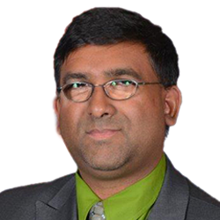

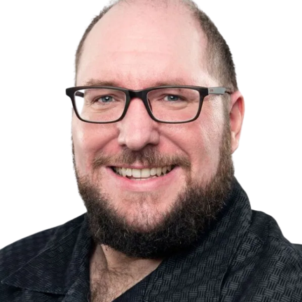
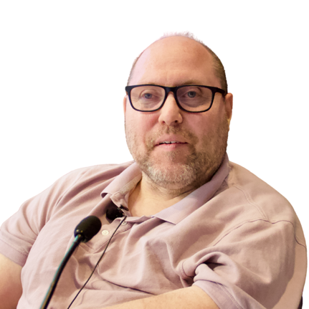
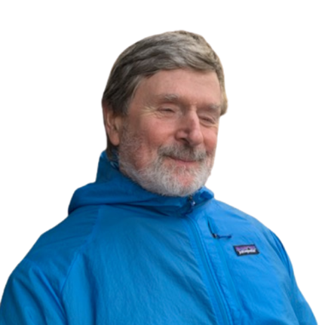
Panel Session
Emile Tompa, Executive Director, IDEA; Department of Economics, McMaster
Rebecca Gewurtz, Director, IDEA; School of Rehabilitation Science, McMaster
Mahadeo Sukhai, Chief Operating Officer, IDEA-STEM
Andrew Dixon, Research Associate, IDEA
Andy Livingston, Chief Executive Officer, Dexterity Consulting
Matt Freeman, Assistant Clinical Professor, McMaster
Peter Field, Diversity and Inclusion Consultant

Slide 50
Employment Accessibility: A Practical Guide for Workplace Parties
An Implementation Guide for CAN/ASC-1.1: 2024 (RE-2025)-Employment
IDEA Symposium, October 6 & 7, 2025
vraie-idea.ca

Slide 51
Implementation Guidance Team
Andrew Dixon, Research Associate, IDEA
Dilshan Fernando, Research Associate, IDEA
Peter Field, Accessibility and Inclusion Consultant
Matt Freeman, Assistant Clinical Professor, Rehabilitation Science, McMaster University
Rebecca Gewurtz, Director, IDEA; Associate Professor, McMaster University
Andy Livingston, Chief Executive Officer, Dexterity Consulting
Mahadeo Sukhai, COO, IDEA-STEM; Adjunct Professor, Faculty of Business and Information Technology, Ontario Tech University
Emile Tompa, Executive Director, IDEA; Senior Scientist, Institute for Work & Health

Slide 52
The Project Team
Our team includes accessibility experts from different disciplines, some of whom are persons with lived experience
Members include policy advisors, human resources expertise, systems thinkers, and academics
Several of the team members are on the Employment standard technical committee

Slide 53
CAN/ASC 1.1: 2024 (REV-2025)- Employment
A revised version of the ASC standard was released at the end of May by Accessibility Standards Canada, available at https://accessible.canada.ca/creating-accessibility-standards/summary-can-asc-112024-rev-2025-employment
The standard envisions a work environment that is accessible, inclusive, barrier-free, and discrimination-free for all workers, including persons with disabilities
It draws on a social model of disability
It promotes removing barriers and providing accommodation without the need for disclosure
Ultimately, the focus is on creating work environments that are inclusive by design

Slide 54
ASC Standard Technical Committee Members
Project manager
Quinn Redekop, Senior Program Advisor, Accessibility Standards Canada
Persons with disabilities and public interest
Mahadeo Sukhai, Researcher, self-employed (Chairperson)
Andrew Livingston, Chief Executive Officer, Dexterity Consulting (Vice Chairperson)
Gary Malkowski, Consultant, self-employed
Monique Beaudoin, Consultant (semi-retired)
Norma McCormick, Founder and Principal, Corporate Health Works Incorporated
General interest
Don Gallant, National Director, Ready Willing and Able, Inclusion Canada
Emile Tompa, Senior Scientist, Population/Workforce Studies Program, Institute for Work & Health
Mark Wafer, Chair, Board of directors, Canadian Hearing Services
Wendy Lau, Chief Executive Officer, Leads Employment Services
Policy makers
Christine Lund, Policy and Program Analyst, Indigenous Services Canada (ISC)
Emmanuelle Lopez-Bastos, Human Rights, Equity and Diversity Coordinator, United Food and Commercial Workers Union
Glen Hayes, Senior Human Resources Advisor, Treasury Board Secretariat
Kelsey Baker, Compensation Consultant, Nova Scotia Education Common Services Bureau
Orelie Di Mavindi, Manager, Opportunities Fund for Persons with Disabilities, Employment and Social Development Canada
Seema Lamba, National Human Rights Officer, Public Service Alliance of Canada
Pamela Lahey (Member October 2020-April 2024)
Standards users
Jamie Burton, Chief Executive Officer, INNoVA
Rachel Desjourdy, Accessibility Lead, CBC/Radio-Canada
Steven Lewis, Manager, Senior Legal Counsel and Accessibility Advisor, Capital One Bank (Canada)

Slide 55
Core Modules of the Standard
There are five core modules/clauses in the standard
Clause 10: Structural support, policy, and leadership
Clause 11: Culture, engagement, and education
Clause 12: Recruitment, hiring, and onboarding
Clause 13: Retention and career development
Clause 14: Development and maintenance of an accessibility support system
https://accessible.canada.ca/creating-accessibility-standards/can-asc-112024-rev-2025-employment

Slide 56
Why is implementation guidance needed?
In general, a standard describes the set of requirements that an organization needs to have in place to meet certain expectations, in this case, being an inclusive employer
Implementation guidance provides advice on the process to achieve the requirement of a standard
The distinction is sometimes described as the what (i.e., the standard) versus the how (i.e., the implementation guidance)
In general, standards are written to be broadly applicable, and guidance assists with contextualizing the requirements
The guidance is being design to support implementation of the ASC Employment standard in different contexts, with a focus on small and medium sized businesses
The process of implementation will vary based on the unique circumstance of each organization

Slide 57
Modules of the Guidance
Part 1: Overview
Chapter 1: Introduction
Chapter 2: Key Concepts
Chapter 3: Management Systems
Chapter 4: Continual Improvement

Slide 58
Modules of the Guidance (cont’d)
Part 2: The How to Guide (core chapters)
Chapter 5: Developing an Employment Accessibility Strategy
Chapter 6: Creating a New Normal Through Leadership and Culture
Chapter 7: Inclusive Recruitment, Hiring and Onboarding
Chapter 8: Inclusive Retention, Promotion and Career Development
Chapter 9: Creating and Maintaining an Accessibility Support System
Part 3: Reporting
Chapter 12: Accessibility Compliance and Best Practices

Slide 59
Setup of Core Modules (Chapters 5-9)
Each of the core chapters is designed to stand on its own, and organized around a continual improvement process (PDCA)
Allows organizations to prioritize and focus
Different teams can take on different modules or different modules can be on different cycles
Emphasis is given to measurement, evaluation and reporting, as well as keeping up with accessibility compliance
NB: Chapter 7 (Inclusive Recruitment, Hiring and Onboarding) will be workshopped in a breakout session this afternoon

Slide 60
Systems Approach to Capacity Building
Traditional approach used to address disability inclusion issues within organizations
Assign responsibilities to a particular person or a team responsible for human resources
Organizations often take a reactive role to accommodation needs, only addressing them as requests are made
Systems approach is proactive and considers roles and responsibilities across the organization
Considers inputs, process, outputs and feedback
Evaluation and improvement on a continual basis
In the disability inclusion space, the intent is to ultimately become inclusive by design

Slide 61
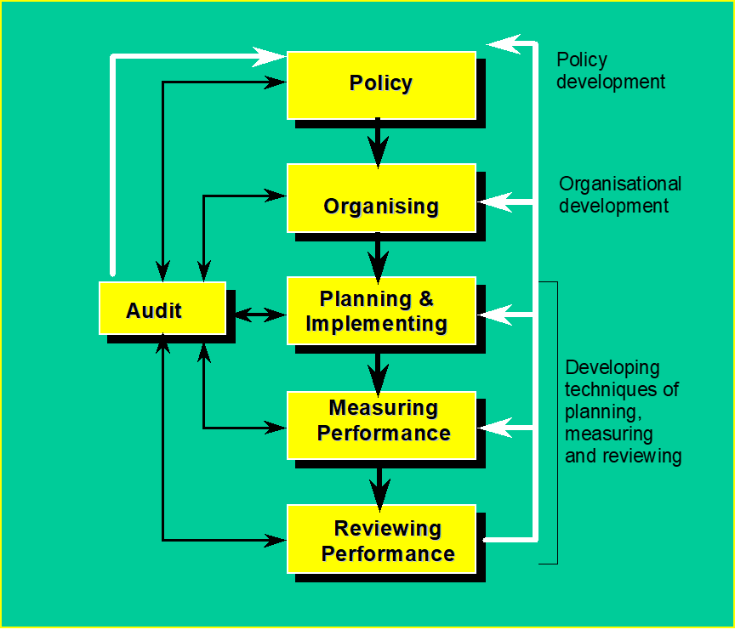
Management System Model*
Policies play a fundamental role in setting clear directions for organizations to follows
Management structures need to be in place to deliver on policies
Requires a planned and systematic approach to implementing policies
Emphasis is given to measurement of performance against targets to identify needed improvements
Reviews and learning from experiences are fundamental to continual improvement
*Health and Safety Executive Model (HSG65)

Slide 62
Continual Improvement
A centrepiece of the approach we take is a focus on systems change through continual improvement
Continual improvement is an ongoing effort to refine a particular area of organizational activities through periodic cycles, specifically:
Developing plans and targets
Implementing the plans
Measuring and evaluating progress and outcomes
Acting on the findings of evaluations to ensure targets are met
Plan-Do-Check-Act (PDCA) is a common approach to operationalizing a continual improvement process

Slide 63
Continual Improvement Cycle
Plan-Do-Check-Act (PDCA)
Continual Improvement Cycle
1. Plan: Establish improvement objectives
2. Do: Implement the plan
3. Check: Monitor and evaluate progress
4. Act: Review and take action to improve
Examples of cycle considerations
Do current recruitment, hiring and onboarding practices provide opportunities for persons with different types of disabilities to access employment opportunities within the organization?
What policies and procedures, roles and responsibilities, resources and skills need to be in place to ensure inclusive practices?

Slide 64
Next Steps
We are looking to get a beta draft of the guidance for public review later this fall
We will be seeking feedback on the beta draft which we will review and use to fine tune the guidance
We hope to do some pilot testing in the field
We have plans to identify/develop supporting materials such as audit tools

Slide 65





www.vraie-idea.ca
bsky.app/profile/vraie-idea.ca
youtube.com/@vraie_idea
linkedin.com/company/vraie-idea
mstdn.ca/@vraie_idea
x.com/vraie_idea
info@vraie-idea.ca

Slide 66
Progress Toward Transformational Change
Break in Progress until 11:45 AM ET

Slide 67
IDEA Applied Work – Tools and Resources from IDEA’s Incubator Hubs

Slide 68
Lightning Talks
Tools and Resources from IDEA’s Incubator Hubs

Slide 69
Transformational Change Equation
Building Research Capacity
Outcomes and Impacts
Inclusive Workplaces
New Applied Research Norms
Mobilizing Knowledge and Scaling Solutions
Co-Designing with Partners

Slide 70
Transformational Change Equation
Building Research Capacity
Outcomes and Impacts
Inclusive Workplace Systems
New Applied Research Practice Norms
Mobilizing Knowledge and Scaling Solutions
Co-Designing with Partners

Slide 71
Scan of Existing Tools and Resources
Identifying and contextualizing existing tools and resources
Each tool/resource is being contextualized to help catalogue it in a tool/resource library
Key contextual considerations:
Core organization activity targeted
Purpose/focus
Type (training, guidance, auditing etc.)
Target audience
Open access (yes/no)
Evidence based (yes/no)
Accessibility features

Slide 72
Delphi Panel
Setting up a modified Delphi panel of experts to help develop and refine an approach for contextualizing the tools and resources identified
Currently recruiting experts for the Delphi panel
Outcome will be a structure for an open access web portal where tools/resources will be catalogued

Slide 73
Gap Analysis
Undertaking a gap analysis of employer unmet needs
Identifying the specific needs employers have when hiring and supporting workers with disabilities
Assessing coverage of existing tools and resources available to employers
Providing recommendations for new or improved resources, tools, and training programs to fill these gaps

Slide 74
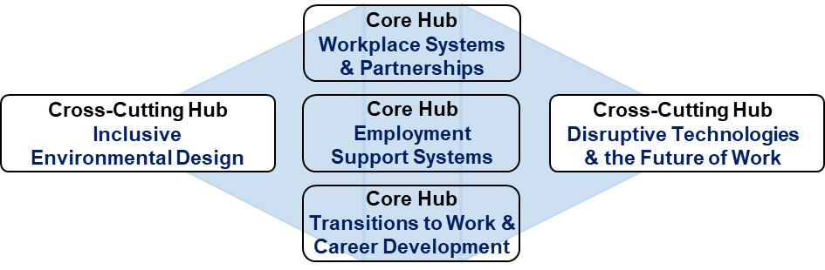
Highlights of Work from Our Incubator Hubs
Lightning talks from Hubs 2-5
In-depth workshops this afternoon with Hubs 1-5

Slide 75
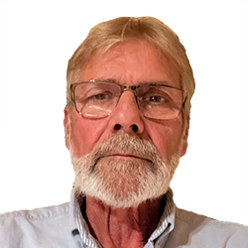
Workplace Systems and Partnerships
Emile Tompa, Executive Director, IDEA; Department of Economics, McMaster
Don Gallant, National Director, Ready, Willing, and Able (RWA)

Slide 76
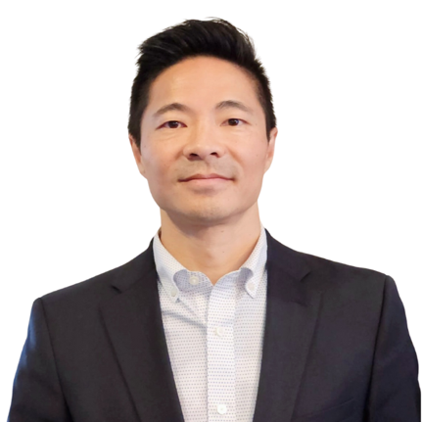
Employment Support Systems
Rebecca Gewurtz, Director, IDEA; School of Rehabilitation Science, McMaster
W. Francis Fung, National Manager, Rehabilitation and Clinical Services at March of Dimes Canada; Engagement Lead, IDEA

Slide 77
Hub 2 Workshop
Building a Culture of Inclusion: Employer supports to empower inclusive workplaces
vraie-idea.ca

Slide 78
Our Focus
Employment Support Services:
Supports for employers
Wrap-around supports for disabled job seekers and workers
Notes:
Rebecca

Slide 79
1. Supports for Employers
What did we do?
Scoping review and key informant consultations exploring types of supports available and needed to help employers hire, retain, and promote people with disabilities
What did we find?
Identified supports needed, and potential strategies/solutions to create inclusive environments and help employers accommodate workers with disabilities
Notes:
Logan

Slide 80
2. Employment Supports for Racialized Disabled Workers
What did we do?
Scoping review and key informant consulations on race and disability within employment supports
What did we find?
Current lack of research highlighting intersections of race and disability in relation to gaining and attaining employment and the need for flexible, personalized support and enhanced training for service providers
Notes:
Eakam

Slide 81
3. Disincentives to Work
What did we do?
Scoping review exploring what has been written about disincentives and incentives to work within government-funded or public income support programs for people with disabilities, and their impact on employment outcomes.
Next steps?
Exploring & contextualizing findings through focus groups
Findings will inform report on income support incentives/disincentives
Report lays groundwork for collaborative co-design with community partners
Goal: shape policy solutions together
Notes:
Holly

Slide 82
Why should you come to our workshop?
Inform how we share our findings
Influence next steps given the current state and future of employment support systems
Notes:
Holly

Slide 83
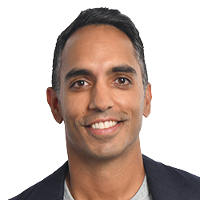
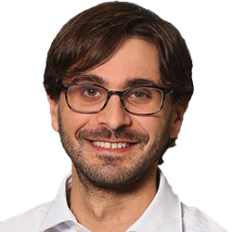
Transitions to Work and Career Development
Arif Jetha, Associate Scientific Director and Scientist, Institute for Work & Health
Sinead McCarthy, Vice President, Development, Programs and Human Resources, Youth Employment Services
Dan Samosh, Assistant Professor, Employment Relations Studies, Queen’s University; Adjunct Scientist, Institute for Work & Health.

Slide 84

Inclusive Environmental Design
Jordana Maisel, Associate Professor, Department of Urban and Regional Planning, and Research Director, Center for Inclusive Design and Environmental Access (IDEA Center)
Mahadeo Sukhai, Chief Operating Officer, IDEA-STEM

Slide 85
Hub 4
Co-Leads: Dr. Jordana Maisel and Dr. Mahadeo Sukhai
Members: Dr. Ji Min Choi, Dr. Rebecca Gewurtz, Dr. Shannon Killip

Slide 86
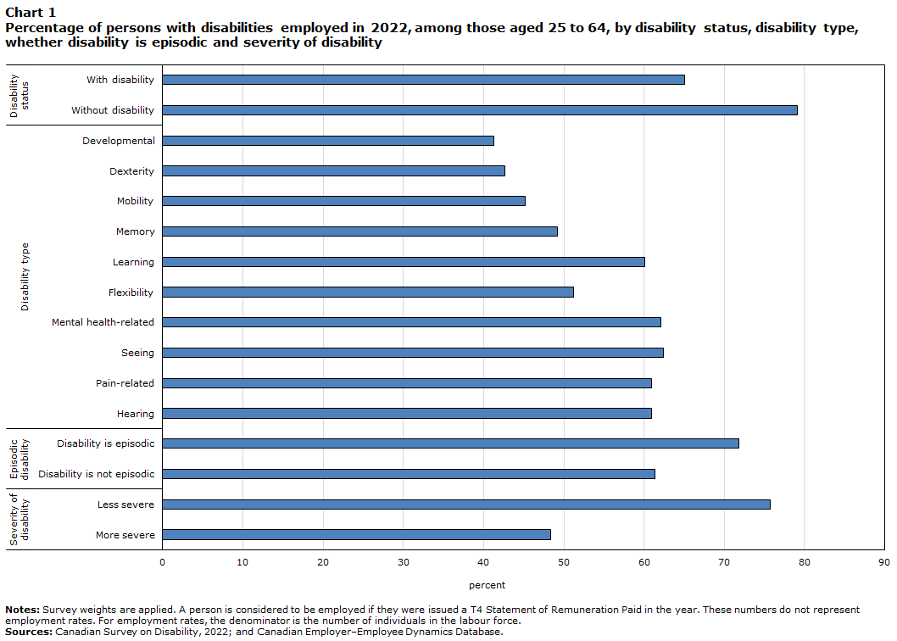

Slide 87
Barriers to Inclusion
Policy
Tech
Social
Attitudinal
Physical
Resources
NIMBY
Emotional
Cognitive

Slide 88
Theoretically Welcoming ➔ Practically Exclusionary
Likelihood (%)
Increasing Responsibility for Decision to Bring in Worker with Disability

Slide 89
Theoretically Welcoming ➔ Practically Exclusionary
Likelihood (%)
Increasing Responsibility for Decision to Bring in Worker with Disability

Slide 90
Two Questions
How do we change workplace culture?
How do we create culture if none exists?

Slide 91
Our Proposed Answer
Commitment
Learning
Systems
Culture Change

Slide 92
Our Approach
What are employers currently doing?
Co-design L&D
Commitment via publicly available data
Implementation Guide (w Hub 1)

Slide 93
Workshop on Training & Resources

Slide 94
IDEA/UD Traiing
What others do
Best practices
Brainstorming

Slide 95
Contact us!
Mahadeo.Sukhai@ontariotechu.ca
Mahadeo.Sukhai@idea-stem.ca

Slide 96

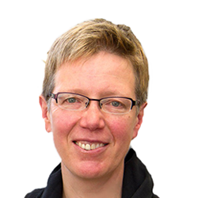
Disruptive Technologies and the Future of Work
Angelika Seeschaaf-Veres, Associate Professor, Industrial Design and Graduate Studies, OCAD University; Co-Director, Radical Norms
Jutta Treviranus, Professor and Director, Inclusive Design Research Centre, OCAD University

Slide 97





IDEA Hub 5
DISRUPTIVE Technology & Future of Work
Co-lead by Angelika Seeschaaf Veres & Dr. Jutta Treviranus | aseeschaafveres@ocadu.ca jtreviranus@ocadu.ca

Slide 98
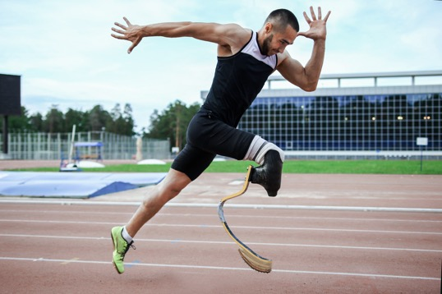

Assistive technologies (AT) are life changers, liberators, equalizers
Assistive Technologies are an intimate extension of the self

Slide 99

Luna…
Interoperability degradation

Slide 100
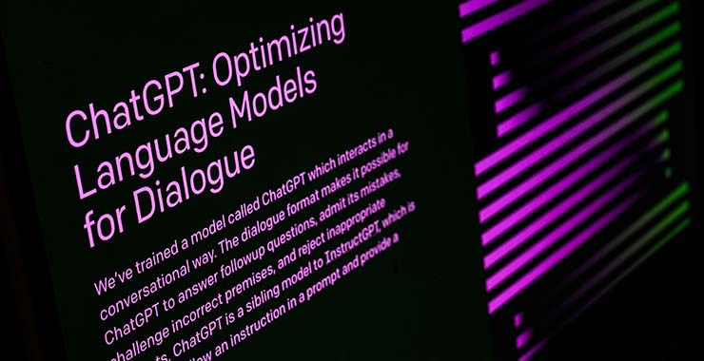
Pete…
Loss of identity & dignified voice

Slide 101
A breakdown of business model, technical model, service model, funding model, research model, impact measurement model

Slide 102
If you have a disability, the opportunities and risks of any disruptive technology are at the extremes. This is especially true for AI.

Slide 103
Extreme opportunities of AI.
Recognize speech, gestures, patterns
Find a target object or pattern
Match and label objects
Remember forever and remind on time
Sort possible paths to find the optimum
Detect common mistakes and correct them

Slide 104
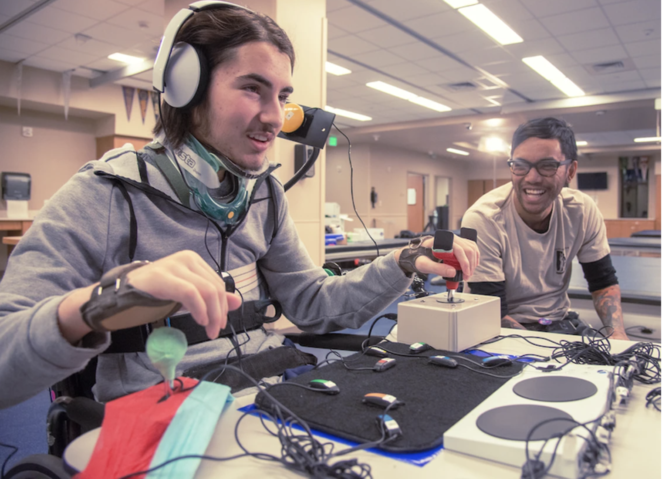
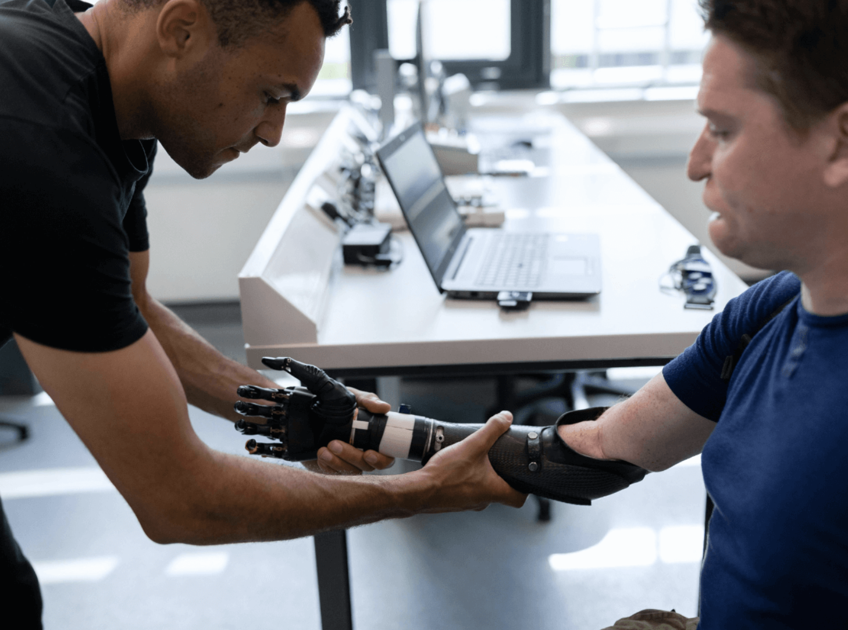
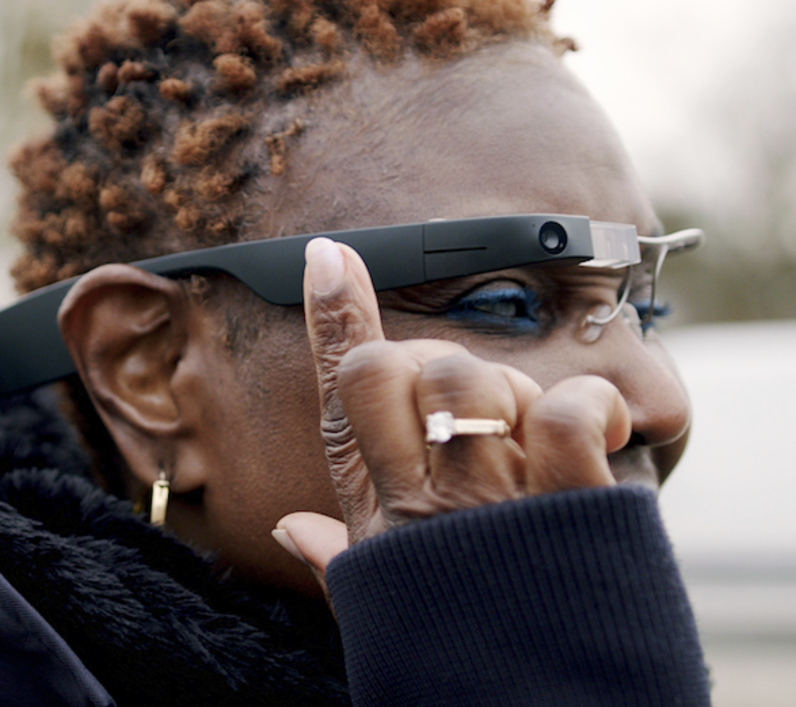
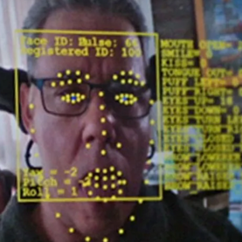
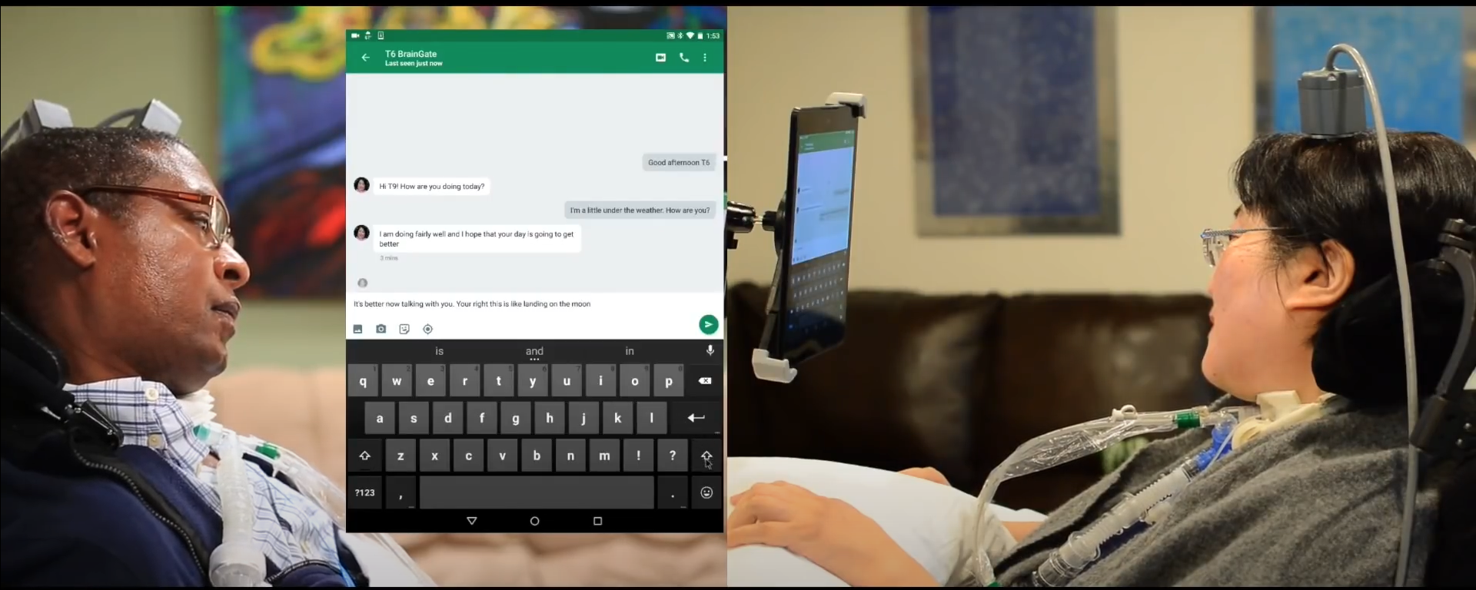

AI is very good at mechanizing the formulaic
AI offers extreme opportunities

Slide 105


Heightened Risks

Slide 106
Find, match, sort, label, measure, optimize, calculate, analyze people ….. at scale

Slide 107

Illustration of the needs of a population platted in a multi variate scatter plot
Multi-variant scatterplot – ‘Human Starburst’
Design & Experience works for 80% of people
AI data highly accurate
Design is difficult to use
AI data inaccurate
Can’t use design
AI data is wrong
https://medium.com/@jutta.trevira/inclusive-design-the-bell-curve-the-starburst-and-the-virtuous-tornado-6094f797b1bf

Slide 108
... AI is propagating discrimination more quickly, efficiently and accurately creating a monoculture

Slide 109
Bias toward the ideal standard = Bias against difference

Slide 110
Disability is the ultimate AI challenge…
Challenge

Slide 111
Illustration of the needs of a population platted in a multi variate scatter plot
IDEA Hub 5 – Emerging Technology & future of work
FLIPPING THE PARADIGM
Weak signals
This is the space of Innovation
https://medium.com/@jutta.trevira/inclusive-design-the-bell-curve-the-starburst-and-the-virtuous-tornado-6094f797b1bf

Slide 112
Filling the Regulatory Vacuum… Accessible and Equitable AI Standard for the Accessible Canada Act… and the EU

Slide 113
Reduce harms
”Trust Meter"
Decision system’s signalling when a model will be unrelatable
Based on data used to train AI

Slide 114
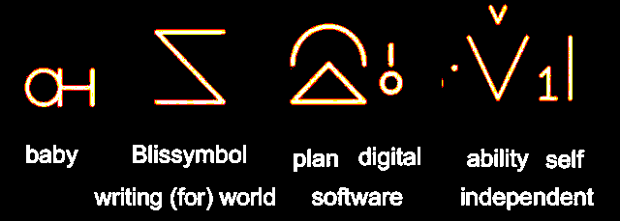
We are developing a language model and an open assistive interface for those who need it most. … “Baby Bliss Bot”

Slide 115
O.I.
From :
To:
:
A.I.
Artificial Intelligence
Outlier Intelligence

Slide 116
Let’s ideate on O.I. for employment access together...

Slide 117
Thank you!
Please get in touch with us:
JuttaTreviranus jtreviranus@ocadu.ca @juttatrevira https://medium.com/@jutta.trevira
Angelika Seeschaaf-Veres
aseeschaafveres@ocadu.ca
www.radicalnorms.com
www.signsofchange.com

Slide 118

https://accessible.Canada.ca
https://idrc.ocadu.ca
https://wecount.inclusivedesign.ca

Slide 119
Progress Toward Transformational Change
Lunch in Progress until 1:30 PM ET
vraie-idea.ca

Slide 120
Afternoon Keynote
Alec Farquhar, IDEA Strategic Advisor; Former Director, Office of the Worker Adviser

Slide 121
The Journey to Disability Inclusion in Canadian Workplaces:
Lessons Learned and Where Do We Go From Here Alec Farquhar Strategic Advisor, IDEA October 6, 2025
vraie-idea.ca

Slide 122
Session objectives
Review the evolution of the approach taken to work disability in policy and practice over the past few decades.
Join me on a journey as I reflect over my career in this space and look to the way forward.
Identify some key learnings that can guide future initiatives.

Slide 123
Personal context
I began in 1973 as an ally and advocate for workers who had injuries or illnesses from their work.
So, the first part of my career was in community organizing and case-by-case advocacy with injured workers with Ontario community legal clinics.
I moved to the Ontario Public Service in 1985, where I became Director of the Office of the Worker Adviser
I worked in the Chair’s Office at the Workplace Safety and Insurance Board,
I was Director of the Ministry of Labour Occupational Health and Safety Branch and of the Occupational Health Clinics for Ontario Workers.
These positions involved me in many strategic initiatives with unions, employers, disability organizations and individual persons with disabilities.

Slide 124
Personal Context - 2
I was also involved in important collaborations with various levels of government and with researchers around disability inclusion.
This includes earlier collaborations with the researchers in the IDEA initiative such as the Centre for Research on Work Disability Policy, which spun off the Disability and Work Canada initiative.
Finally, I was active with the Ontario Bar Association, a leading champion of disability inclusion where major collaborations of worker and employer representatives have taken place.
So, I have had five decades of involvement in the evolving space of disability inclusion and have been part of many efforts to make a difference.

Slide 125
Where did we start from?
I started my years of advocacy in 1973 as a first-year law student working with the Union of Injured Workers.
This meant dealing mainly with blue collar workers, many of them immigrants, from sectors like construction, manufacturing and mining.
In those days, not far from the location of this symposium, there were manufacturing establishments including the needle trades, furniture, farm equipment and major appliances.

Slide 126
Where did we start from - 2
And a new Toronto was being built.
Many such workers suffered serious physical injuries along with gradual onset disablements from over-stressed backs, arms and legs.
Unfortunately, it was a common occurrence for these workers to lose their jobs, as employers wanted 100% fit people to handle such physically demanding work.
I was involved in numerous cases where we litigated and even engaged in public protests to try to press employers to take back their injured workers.

Slide 127
Where did we start from - 3
Sometimes, especially in unionized environments, accommodations were made to allow injured workers to return to work.
There was a tendency to create specific positions for workers with disabilities, or even whole disability units in large manufacturing establishments, rather than finding ways to include them in regular positions.
This approach was mirrored for persons with disabilities, where many spent their working careers in sheltered workshops.
Unfortunately for some, especially those with intellectual disabilities, they are still being institutionalized.

Slide 128
Initial responses – a rights- and benefits-based movement
The 1970s were a time of social ferment on a broad scale—around women’s issues, racism, First Nations, refugee and gender issues, to name some of the most important ones.
Disability activism co-evolved with all of this.
In Ontario, injured workers had a famous sit-in right outside the Chamber of the Legislature in 1974 and many other public protests across the province.
That same year was the historic wildcat strike in the Elliot Lake uranium mines, where 10,000 miners shut down uranium production in the midst of the Cold War.
In this context, a common theme for persons with disabilities, including injured workers, was legal rights and secure income supports.
Much of the call for income supports resulted from a lack of disability inclusion in the workplace.

Slide 129
Progress on legal rights
While Ontario had included “handicap” in its Human Rights Code since 1962, in the 1970s there was a campaign and policy development process to shift to the more inclusive term “disability,” leading to legislative amendments in 1981.
This opened the door to litigation expanding the scope of disability accommodation.
It also set the stage for referencing the Human Rights Code in Ontario’s workers’ compensation legislation later on.
Broadly speaking, at least some elements of disability discrimination could be successfully challenged in various forums, including labour arbitrations under collective agreements.

Slide 130
Progress on legal rights - 2
1982 saw the signing of the Canadian Charter of Rights and Freedoms, which initially was not going to include disability as a protected ground but ultimately did so, following a determined and very effective campaign.
And more recently we have welcomed the UN Convention on the Rights of Persons with Disabilities, which came into force in 2008 and was ratified by Canada in 2010.
The federal government and many provinces have also moved forward on accessibility legislation and standards, including the federal employment standard discussed at this symposium.
Overall, Canada and its provinces now have a reasonably robust legal rights framework supporting disability inclusion in the workplace.

Slide 131
Champions
As I think back to those earlier days, there were many champions and activists who helped move the yardsticks.
I would like to highlight one of our most outstanding champions – David Onley. We lost David in 2023, and he is greatly missed.
David’s journey personified the evolution of disability inclusion over several decades.
He had polio as a young child, leaving him with a lifelong physical disability.
He had a lot of trouble finding employment but ended up with a distinguished career in TV journalism.
He put a human face on disability inclusion for thousands of people.
Then he moved the value of inclusion to a whole new level when he was appointed Ontario’s Lieutenant-Governor in 2007.

Slide 132
Champions - 2
This gave David the platform to bring key stakeholders, disability organizations and government together to spearhead disability inclusion.
Among the collaborators whom David brought to the table was Mayor Mike Bradley of Sarnia, who will be speaking later today at our symposium.
David was the right person at the right time, to move disability inclusion to a more systemic, strategic level, involving collaboration within civil society at a level not seen previously.
He challenged workplaces, including employers and unions, to become truly inclusive and to support all employees in achieving their full potential.
He has given us all a solid foundation to take this work further, broader and deeper.

Slide 133
Broadening the concept of disability
A vital development in the 70s, 80s and 90s was the broadening of Canadians’ concept of disability.
This included two main elements.
First was the growing recognition of a broader range of disabilities, versus the earlier focus on major physical impairments.
So, in my own work, I was part of the efforts to gain recognition for mental health conditions resulting from traumatic and gradual onset stress in the workplace.
And also, for chronic pain that continued after the physical injury had largely healed.
Out in the community, mental health began to be seen not as a sign of personal weakness (and shame) but a disability like any other.
These developments also aligned with the evolution of our economy away from blue collar jobs to white collar ones.

Slide 134
Broadening the concept of disability- 2
Second was the shift from a medical model to a social model. of disability.
This was a real breakthrough in conceptual and practical terms.
It meant that we began to see disabilities in their social context created by barriers in the environment.
This new understanding opened the door to much more robust discussions of accommodation and inclusion.
This is vital to our future work because it validates that changes to the social and organizational context can greatly strengthen disability inclusion in the workplace.

Slide 135
The evolution of disability programs
Many of the earliest disability programs provided financial support to persons with disabilities who could not work, or who could not find work.
It was not uncommon for a student with a disability to “graduate” onto a disability program and never find a job.
Or for an injured worker to lose a good paying job and try to survive on poverty level benefits.
There were also major problems with the lack of alignment of these programs, often including major disincentives for people to enter the labour force.
This included the fear of losing supports for daily living which were provided by many programs.

Slide 136
The evolution of disability programs- 2
Many of us in the disability-and-work space dedicated major efforts at reform of these programs so that they provided support that maximized the potential for people to work without risking their financial survival and health.
I was involved in several major efforts to do this, sometimes with significant government support.
This was an early focus of my collaboration with Emile on the Centre for Research on Work Disability Policy and more recently with Emile and Rebecca, on IDEA.
A lot of researchers and policy experts devoted their careers to designing better programs.
One idea that emerged from this was providing persons with disabilities with a “backpack” of supports which would travel with them whether they were working or not.

Slide 137
The voice and leadership of persons with disabilities
Perhaps my most powerful experiences were from hearing the voice and seeing the leadership of persons with disabilities.
In earlier times, it was often people who had struggled for recognition and for their voice to be heard.
When I am in this part of town, I often think of John Rae, who died in 2022.
He was a tireless advocate in the community and at the national policy level, and whose work covered the same time period as mine.
Right up to our last lunch together near here, shortly before he died, I was learning from him and reframing my concept of the challenges and solutions.
Some of these were not easy conversations but were invaluable.

Slide 138
Leadership of persons with disabilities - 2
There has been a tremendous evolution in this crucial aspect of work in this space.
In the early years it was often persons with disabilities out in the community trying to increase workplace disability inclusion.
Now there are often significant avenues and structures within the workplace.
This includes enterprise-wide committees of persons with disabilities and persons with disability caucuses in some unions.
Many unions have designated leadership positions for persons with disabilities.

Slide 139
The evolution in the role of research
When I first became involved in this space, very few academic researchers were involved.
There were some who studied disability programs such as workers’ compensation, but very rarely did they focus on the workplace itself and how to make it more inclusive.
This meant that we developed our own solutions to address challenges in the policy and practice arena.
Many were very effective but not necessarily supported by evidence.
Over the decades there has been a great increase in the quantity and quality of academic research in this space.
That includes knowledge-to-action initiatives such as IDEA, and this symposium itself.
Having rigorous research involvement is invaluable in making the case for change, in particular systems change, and for supporting continuous improvement.

Slide 140
Developing a systems approach to disability inclusion
In the initial decades, a common approach when encountering a specific issue or challenge was to develop micro-level solutions for it.
Many small, standalone solutions were generated.
A major development of the past decade has been the growing acceptance of a systems approach.
This includes comprehensive standards such as the Canadian Standards Association’s Work Disability Management System Standard Z-1011:20.
Taking a systems approach empowers workplaces to advance in a coordinated way, through continual improvement, on several fronts at the same time.

Slide 141
Making the business case for disability inclusion in the workplace
When I first became involved with workers’ compensation, it was commonplace for disability issues in the workplace to be compartmentalized.
There was one stream for injured workers, another for workers with non-occupational disabilities.
The same was true of income support in the workplace – workers’ compensation costs were in one part of the budget, long term disability in another.
And I don’t think I encountered in those days any employer who carried out anonymous surveys allowing employees to express their views on how they were being treated.
In the broader disability community and related support network, things were similarly siloed.
The end result was a hodge podge of siloed support program and no understanding of the total economic and human cost of disability and the cost of exclusion.

Slide 142
The business case - 2
Unfortunately, there were also incentives to do the wrong thing.
For example, you could reduce your workers’ compensation “experience rating” assessments by aggressive claims management rather than addressing the underlying health risk exposures or safety practices.
Things have changed dramatically since then--many organizations have a better idea of the overall costs of disability and the benefits of inclusion.
And society wide, we have studies such as the groundbreaking one by Tompa et al (2019) that showed the benefit of disability inclusion to Canada’s economy at an astonishing 17.6% of GDP!

Slide 143
The way forward
I have been fortunate to witness a sea change in the Canadian approach to disability inclusion in the workplace.
I am aware there are remaining challenges, including especially the lack of decent income support and continuing issues around the design of disability programs.

Slide 144
The way forward - 2
However, in my view the foundations for creating truly inclusive workplaces are now in place, including:
A broadening of the scope of accepted disabilities, especially to include mental health
A reasonably strong legal framework
Acceptance by many of the social model of disability
A stronger voice for persons with disabilities and acceptance of “nothing without us”
Many champions in the policy and practice arena, including people at leadership levels such as Mayor Mike Bradley and the late David Onley
As well, Champions in the academic arena such as the late Dr. Marcia Rioux
The notion of employer capacity building as the best way forward
The new focus on systems level solutions
The broader acceptance of the need for a new normal where everyone can thrive
Integrated approaches for developing the business and human case for change

Slide 145
The way forward - 3
I believe that the current challenge is to build on all of this and move forward ambitiously with workplace disability inclusion. And that is what this symposium is all about.

Slide 146
www.vraie-idea.ca
bsky.app/profile/vraie-idea.ca
youtube.com/@vraie_idea
linkedin.com/company/vraie-idea
mstdn.ca/@vraie_idea
x.com/vraie_idea
info@vraie-idea.ca

Slide 147
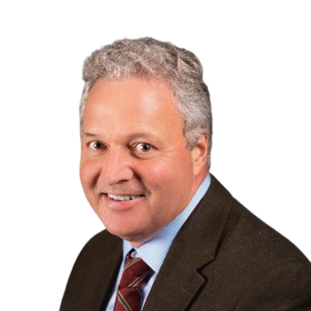
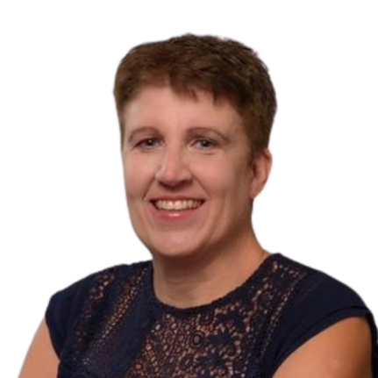
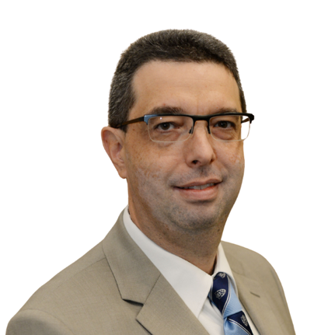


Panel Session
Alfred MacLeod, Assistant Deputy Minister, Public Service Accessibility, Treasury Board of Canada Secretariat, Government of Canada
Nadine Charron, Executive Director, Accessibility, Accommodation and Adaptive Computer Technology (AAACT) Program, Shared Services Canada
André Baril, Director General, Accessibility and Disability Inclusion Projects, Employment and Social Development Canada
Angela Wellman, Chief of Staff/Senior Advisor, Office of Public Service Accessibility, Treasury Board Secretariat
Ashvene Sureshkumar, Research Associate, IDEA

Slide 148
IDEA-Government of Canada Collaboration
IDEA Symposium, October 6, 2025
vraie-idea.ca

Slide 149
Overview of the collaboration
IDEA is collaborating with the Government of Canada (GC), to provides advice and recommendations to help recruit, retain and advance employees with disabilities across the Public Service of Canada and beyond
To support these efforts, IDEA is conducting research and knowledge mobilization activities
The collaboration operates using the principles of codesign and “Nothing about us without us.”
Evidence-informed tools and resources developed as part of this collaboration will be shared widely, including the private sector and not-for-profit organizations, the public sector, scholars, and other interested stakeholders

Slide 150
GOVERNANCE FOR THE MOU
Est. September 2023
GC – Government of Canda
ESDC – Employment and Social Development Canada
OPSA/TBS – Office of Public Service Accessibility, Treasury Board of Canada Secretariat
SSC – Shared Services Canada
PSPC – Public Services and Procurement Canada
CSPS – Canada School of Public Service
ODI – Office for Disability Issues
Governing Committee
DM - ESDC, ADM - OPSA,
ED -IDEA (McMaster)
Steering Group
OPSA, ESDC, IDEA
SSC, PSPC, CSPS and ODI Project Leads
Project 1 – Working Group (AAACT Scaling)
SSC Lead
IDEA
(To be completed December 2025)
Project 2 – Working Group (Supply Arrangements)
PSPC Lead
IDEA
(To be completed March 2026)
Project 3 – Working Group (Accessibility Training)
CSPS Lead
IDEA
(Completed September 2025)
Project 4 – Working Group (Workplace Benefits)
ODI Lead
IDEA
(Completed September 2025)

Slide 151
Project Overviews
Project 1: Scaling an Accessibility, Accommodation and Adaptive Computer Technology Program
Project 2: Identifying Requirements for Procurement of Human Resources Accessibility Expertise to Support Employment of Persons with Disabilities
Project 3: Advancing Accessibility Training at the Canada School of Public Service
Project 4: Contextualizing the Lack of Workplace Benefits within the Range of Barriers to Employment for Persons with Disabilities: Best Practices for Employers

Slide 152
Project 1 Key Objective
To explore how AAACT can expand and stabilize its services so that all GC employees can quickly and easily access the resources they need to provide accessible and disability inclusive workplaces, systems, and digital content.

Slide 153
Project 1 Key Activities
Phase 1:
Drawing on knowledge from key informants and the literature; develop a Logic Model of the key contextual domains and components of an effective and comprehensive accommodation program that is disability-inclusive
Benefit-cost analysis of the return on investment of the AAACT for the GC
Phase 2:
Stylized case studies which highlight the return on investment for employees and the government through AAACTs services
Research key performance indicator (KPI) including KPI frameworks

Slide 154
Project 2 Key Objectives
To develop guidance for organizations on how to take an inclusion lens when buying and selling goods and services, and generally in procurement systems and processes.
To support efforts to foster inclusive workplaces and consider the needs of persons with disabilities in all areas of procurement, with a focus on “human resources (HR) services with accessibility expertise.”

Slide 155
Project 2 Key Activities
Undertake literature review of best practices for the procurement of accessibility expertise
Review the current PSPC professional services methods of supply
Undertake external engagement of public and private sector Canadian and international organizations external to the GC
Undertake internal engagement with GC public servants involved with the procurement of HR services with accessibility expertise

Slide 156
Project 3 Key Objective
To provide advice to the CSPS on enhancing the impact of EDIA training for diverse audiences.

Slide 157
Project 3 Key Activities
Undertake a literature review and research summary on:
best practices for disability inclusion and accessibility training
integration of EDIA training for diverse audiences, with a particular focus on managers and human resource practitioners

Slide 158
Project 4 Key Objective
To explore the role of workplace benefits within the range of potential barriers and facilitators to employment—including understanding the importance of benefit packages for persons with disabilities in accepting and retaining employment.
To provide actionable recommendations for employers to help address barrier to the employment of persons with disabilities.

Slide 159
Project 4 Key Activities
Phase 1:
Develop demographic and income profiles of working-aged persons with disabilities in Canada
Undertake a scoping review to better understand the role of workplace benefits availability within the context of barriers and facilitators to employment for persons with disabilities
Undertake key informant interviews with persons with disabilities employers and employment service providers
Phase 2:
Develop promising practices guidance tool for employers based on Phase 1 findings
Gather key feedback on guidance tool from stakeholders through workshops

Slide 160
Logic Model/Theory of Change for Investing in Accessibility
Vision: To foster a public service that is inclusive by design and accessible by default, where every GC employee has access to participate fully without barriers.
Domains and Inputs
(Resources)
Activities
(Programs and services)
Outputs
(Tangible results)
Outcomes
(Specific and measurable effects)
Impacts
(Valued returns to the organization)
Enterprise Wide AAACT Program
Develop, implement and monitor:
Individualized workplace adjustment services;
Formalized procurement activities;
Training, testing and advisory services; and
An Accessibility Passport Program.
More effective and timely accommodation of new and longstanding GC employees with disabilities
Disability confident GC organizations.
Improved inclusion for GC employees and accessibility of GC organizations.
Increased job and career satisfaction of GC employees with disabilities.
Obligations under the Accessible Canada Act met and exceeded.
GC seen as a role model employer across Canada and internationally.
Training Initiatives
Develop, deliver and monitor a suite of courses for different GC employee roles and responsibilities on respectful and inclusive workplace practices.
Increased productivity of GC employees with disabilities, their teams, and their supervisors
GC employees well versed in best practices for inclusive teams work and communications
Procurement System
Implement and monitor inclusive procurement best practices where a disability inclusion lens is taken in all procurement activities.
Continual improvement processes across all domains and activities
Disability champions and advocates
Improved retention of GC employees with disabilities
Development, implement and monitor of:
An employment accessibility strategy;
Inclusive recruitment, hiring and onboarding policies, programs, services and structures; and
Inclusive professional development and career advancement policies, programs, services and structures.
Employment/HR System
Community of practice on effective and timely accommodation
Increased employment of persons with disabilities in the GC labour force
Leadership and Culture
Develop, lead and promote a culture of accessibility and inclusion.
Disability focused Employee Resource Groups
GC savings in accommodation costs from economies of scale

Slide 161
Potential Knowledge Mobilization Activities
Internal briefings
Presentations of findings
Public version of report on the IDEA website
Social media posts
Development of tools and resources for broad application
Academic publications

Slide 162

www.vraie-idea.ca
x.com/vraie_idea
youtube.com/@vraie_idea
linkedin.com/company/vraie-idea
mstdn.ca/@vraie_idea
instagram.com/vraie_idea
info@vraie-idea.ca

Slide 163
Workshops
W280
Workplace systems and partnerships: Employment standard implementation guidance – chapter 7
Transitions to work and career development: Making high-quality jobs and career advancement opportunities accessible and disability inclusive
W240
Disruptive technologies and the future of work: Shaping Inclusive AI tools for Employment Access
Employment support systems: Building a culture of inclusion – supports to empower inclusive workplaces
W762
Inclusive environmental design: Training & resources for inclusive workplaces

Slide 164
Progress Toward Transformational Change
Break and Workshops in Progress
until 4:40 PM ET
vraie-idea.ca

Slide 165

Closing Keynote
Mayor Mike Bradley, City of Sarnia, Ontario

Slide 166
Closing Reflections/Announcements
Alec Farquhar, IDEA Strategic Advisor; Former Director, Office of the Worker Adviser
Sinead McCarthy, Vice President, Development, Programs and HR, Youth Employment Services; IDEA Hub Co-lead for Transitions to Work and Career Development
Emile Tompa, Executive Director, IDEA; Department of Economics, McMaster
Rebecca Gewurtz, Director, IDEA; School of Rehabilitation Science, McMaster

Slide 167
Funding Acknowledgement
Inclusive Design for Employment Access (IDEA) is supported by generous funding from the Government of Canada’s New Frontiers in Research Fund (NFRF).
Le Vision Radicale Pour L’Accès Inclusif à l’Emploi (VRAIE) est financé par le fonds Nouvelles frontières en recherche du gouvernement du Canada.

Slide 168
Reception from 5:20 – 6:30 PM ET
vraie-idea.ca

