Slide 1




The Win-Win of Designing Workplaces for Disability Inclusion
IDEA Symposium, October 6 & 7, 2025
vraie-idea.ca

Slide 2
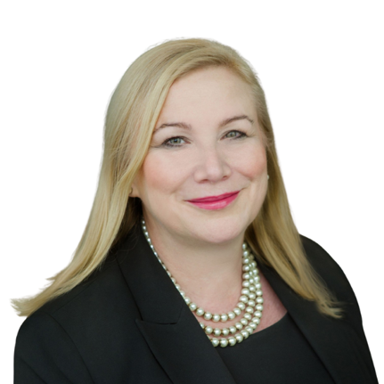


Welcoming Remarks
Wendy Cukier, Director, Diversity Institute, Toronto Metropolitan University; IDEA Advisory Committee Member
Peter Field, Diversity and Inclusion Consultant
Karen Harlos, Professor, Department of Business, University of Winnipeg

Slide 3


Opening Keynote Address
Bilan Arte, National Representative, Human Rights Department, Canadian Labour Congress; IDEA Advisory Committee Member

Slide 4
Unions Deliver
Capacity Building For Workplace Disability Inclusion

Slide 5

The Union Advantage
Historic action driven by workers with disabilities within unions to promote and sustain more accessible and inclusive workplaces.
The result: sectors with higher union density correlate with higher employment rates for people with disabilities.

Slide 6



Examples From The Field
United Food and Commercial Workers (UFCW) of Canada Local 832’s Different Abilities Program (Manitoba)
Ontario Network for Injured Workers Groups
CUPE Workers With Disabilities Led Activism with Government

Slide 7
Key Take Aways
Unions are powerful partners in designing and implementing employment programs that target workers with disabilities. Employers need to prioritize collaboration at the onset, not just when there is an accommodation or accessibility issue that requires resolve. We can be proactive by prioritizing collaboration and meaningful inclusion.
Unions have a proven track record of success, and it’s no coincidence that people with disabilities have the highest rates of employment within unionized sectors.
Unions are on the front lines of innovation on employment for persons with disabilities because our organizations include intentional and meaningful leadership opportunities for workers with disabilities at almost every level.
Unions have a representative structure that creates a dynamic that prioritizes and amplifies the voices of workers with disabilities with a diversity of lived experiences both at work and in our communities.

Slide 8
When workers with disabilities and allies unite, they can achieve transformative change at work and in their communities

Slide 9

Doing Things Differently:
A Disability Rights At Work Handbook
Available at: https://canadianlabour.ca/doing-things-differently-guide/

Slide 11

Thank You

Slide 12
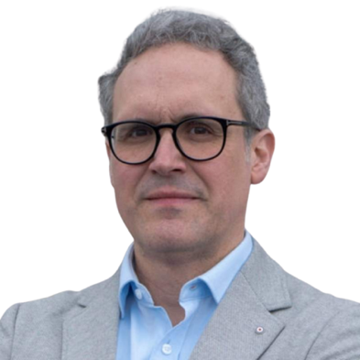





Panel Session
Rafael Gomez, Director, CIRHR, University of Toronto; Initiative Co-lead
Jonathan Lai, Executive Director, Autism Alliance of Canada
Andrew Dixon, Research Associate, IDEA
Sinead McCarthy, Vice President, Development, Programs and HR, Youth Employment Services
Brian Foster, National Program Manager, Policy & Resource Development, Ready Willing and Able (RWA), Inclusion Canada
Emile Tompa, Executive Director, IDEA; Department of Economics, McMaster

Slide 13
Transforming Workplace Systems to Build Sustainable Capacity for Inclusion of Diverse Youth
IDEA Symposium, October 6 & 7, 2025
vraie-idea.ca

Slide 14
Focus of the YESS initiative
Build employer capacity to create barrier-free, disability-inclusive workplaces through cross-sector partnerships and research
Target the construction/building trades and manufacturing and sectors
Target population is youth with learning disabilities, attention-deficit/hyperactivity disorder (ADHD), neurodiversity, with intellectual disabilities, and with mental health challenges
Identify resource gaps, develop and test innovative and high-impact solutions, with scalability and sustainability in mind

Slide 15
Partners
Key Community Partners
Inclusion Canada/Ready, Willing and Able (RWA)
Autism Alliance of Canada
Youth Employment Services (YES)
Other Key Partners
Automotive Parts Manufacturers’ Association (AMA)
Provincial Building & Construction Trades Council of Ontario
Canadian Chamber of Commerce
Canadian Labour Congress (CLC)
Enhancing the Prevention of Injury and Disability at Work (EPID@Work)
Holland Bloorview
March of Dimes Canada
Ontario Bar Association
Ontario Disability Employment Network (ODEN)
SkillPlan
Unifor

Slide 16
Current Activities: Scan of Existing Tools and Resources
Identifying and contextualizing existing tools and resources
Inform the cataloguing for inclusion in a virtual tools and resources library
Key considerations for contextualization :
Core organization activity targeted
Purpose/focus
Type (training, guidance, auditing etc.)
Target audience
Open access (yes/no)
Evidence based (yes/no)
Accessibility features

Slide 17
Current Activities: Delphi Panel
Setting up a modified Delphi panel of experts to help develop and refine the contextualizing approach
Currently recruiting experts for the panel
Outcome will be a stakeholder informed structure for an open access web portal where tools/resources will be catalogued

Slide 18
Current Activities: Gap Analysis
Undertaking a gap analysis of employer unmet needs
Assessing coverage of existing tools and resources available to employers
Identifying the specific unmet needs employers have when hiring, onboarding, and retaining workers with disabilities
Providing recommendations for new or improved resources, tools, and training to fill these gaps
Addressing these unmet need with our partners

Slide 19
Target outcomes of the initiative
Creation of a platform and resource hub for employer tools and resources
Development of new products
Collaborations with industry partners to pilot and evaluate capacity building initiatives
Broad adoption of existing and new tools and resources

Slide 20
Shout-Out for the Other YESS Funded Initiatives in this Envelope
Five other initiatives funded within this YESS program RFP:
Mentor Canada
Inclusion Canada/RWA
Tamarack Institute
Prepr
Saint John Learning
Posters for the first four are on display in the lobby

Slide 21
Break in Progress until 11:15 AM ET

Slide 22








Partner Lightning Talks

Slide 23
Diversity Institute
Wendy Cukier, Director, Diversity Institute, Toronto Metropolitan University

Slide 24


Strategies for Advancing Disability Inclusive Workplaces
October 7, 2025
Wendy Cukier, MA, MBA, PhD, DU (hon) LLD (hon) M.S.C.
Academic Director, TRSM Diversity Institute
Academic Research Director, FSC
IDEA Symposium

Slide 25
Context
Disruption caused by technology, particularly AI, is eroding entry level positions
Disruption caused by trade wars is having impact across sectors
Cuts to immigration have created skills shortages in some sectors
Demographic shifts - 27% of Canadians now identify as having a disability, often with intersectional perspectives
Persons with disabilities are still under-employed, underpaid and experience barriers along their career pathway
Backlash against IDEA, misinformation, legitimization of discrimination and hate

Slide 26
Ignore the Noise: Overwhelming Proportion of Canadians Still Support IDEA (Environics, 2025)
54% of Canadians think that focusing on increasing IDEA at work is mainly “a Good thing”, with 27% saying it is neither bad or good, and only 16% saying it is “a Bad thing.”
47% of Canadians feel their employer’s approach to IDEA has had a positive impact (very and somewhat) on their opportunities at work, while only 12% feel it has had a negative impact (very and somewhat).
Canadians also believed that their company pays “too little attention” to IDEA (22%)
26

Slide 27
Persons with Disabilities - Key Issues
Access to education | Access to employment and workplace inclusion | Leadership
Almost one-third of youth with more severe disabilities are neither in school nor employed About 9% of women and 12% men stopped their education due to insufficient support Disciplinary segregation | In 2023, employment rate lower without disability (47% vs 67%) 33% experience workplace discrimination (58% for those with cognitive difference) Only 0.5% of all SMEs in Canada are majority-owned by persons living with disabilities Wage Gap – 79% University grads with severe disabilities have worse employment outcomes than high school dropouts | 3% of distributing corporations have at least one director who is a person with a disability 4% of distributing corporations have at least one member of their senior management who is a person with a disability
Notes:
Sources:
Column 1, point 1: Statistics Canada. (2018). Canadian Survey on Disability 2017. https://www150.statcan.gc.ca/n1/daily-quotidien/181128/dq181128a-eng.htm
Column 1, point 2: https://www150.statcan.gc.ca/n1/pub/36-28-0001/2021010/article/00003-eng.htm
Column 2, point 1: Statistics Canada. (2023). Labour market characteristics of persons with and without disabilities in 2022: Results from the Labour Force Survey. https://www150.statcan.gc.ca/n1/daily-quotidien/230830/dq230830a-eng.htm
Column 2, pt 2: Cukier et al (2024). Gender, Diversity and Discrimination in the Workplace. Diversity Institute. https://docs.google.com/document/d/1EQ_BunBiSWW1bENUSpJS6Y-h7nFed_gZ/edit
Column 2, pt 3: Brault, M. (2021). Shining an entrepreneurial spotlight on the disability community. BDO Canada. https://www.bdo.ca/insights/disability-inclusion-business-ownership#:~:text=Only%200.5%25%20of%20all%20SMEs,by%20leaders%20without%20a%20disability
Column 3: https://ised-isde.canada.ca/site/corporations-canada/en/data-services/diversity-boards-directors-and-senior-management-federal-distributing-corporations-2023-annual#s5.5

Slide 28
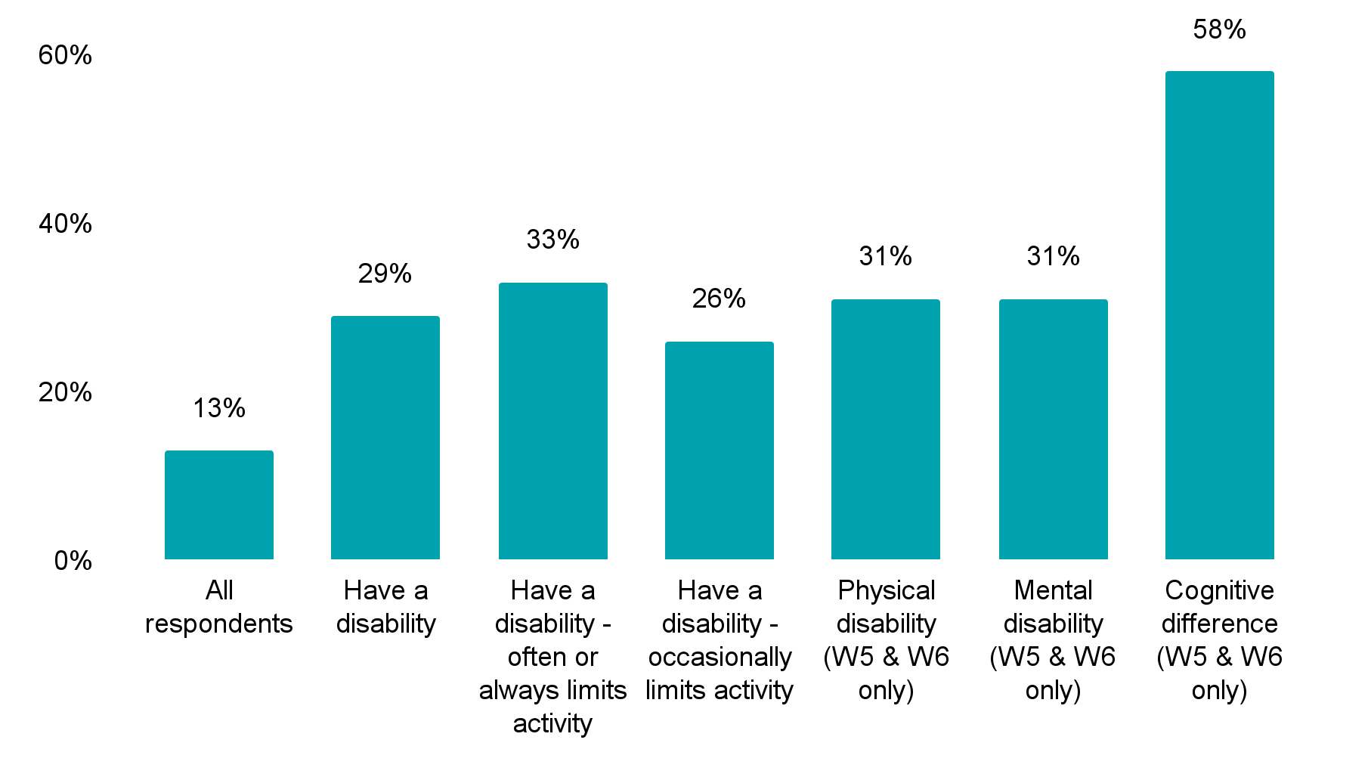
Discrimination by disability status (n=40,000)
Notes:
Sources:
Cukier, W., Parkin, A., Saiphoo, A., & Edwards, M. (2024). Gender, Diversity and Discrimination in the Workplace. Diversity Institute, Future Skills Centre, Environics Institute. https://www.torontomu.ca/content/dam/diversity/reports/gender--diversity-and-discrimination-in-the-workplace/Gender,%20Diversity%20and%20Discrimination_EN.pdf

Slide 29
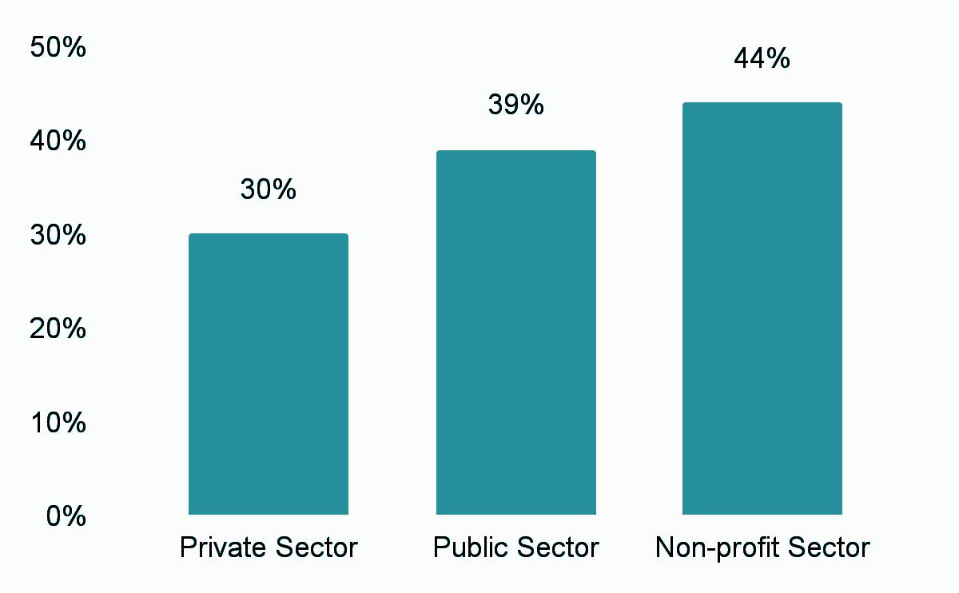
Disability-based discrimination by sector
Notes:
Sources:
Cukier, W., Parkin, A., Saiphoo, A., & Edwards, M. (2024). Gender, Diversity and Discrimination in the Workplace. Diversity Institute, Future Skills Centre, Environics Institute. https://www.torontomu.ca/content/dam/diversity/reports/gender--diversity-and-discrimination-in-the-workplace/Gender,%20Diversity%20and%20Discrimination_EN.pdf

Slide 30
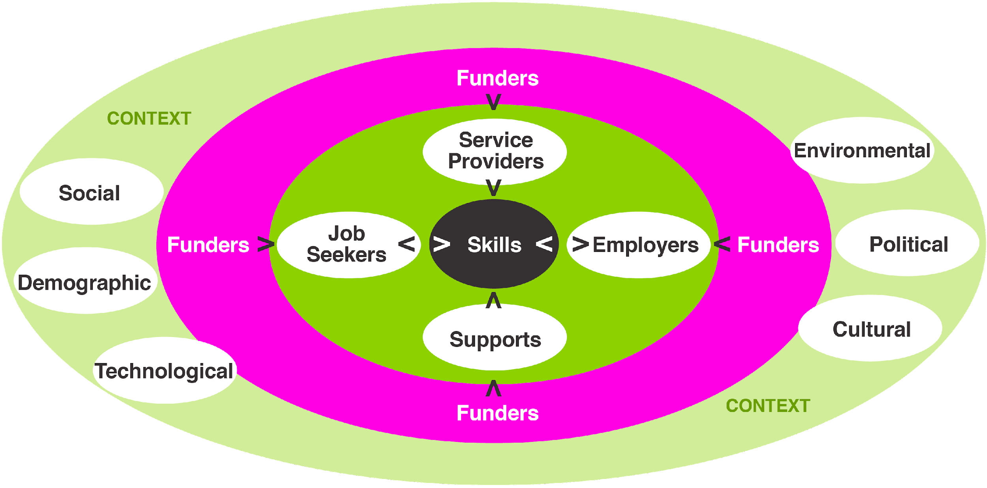
The Way Forward
Notes:
Sources:
Cukier, W., Jahangir, Y-T., & Hinz, F. (2023). Engaging Employers in Activating Persons with Disabilities. Diversity Institute, Internal

Slide 31

Opportunities
Disaggregated data, distinctions and intersectionality
Bring a disability lens to the design, implementation and evaluation of all government policies (more than just the +)
Identify and eliminate ablest and neurotypical bias in assumptions, policies, and culture
Pathways through education to employment
Incentives for employers – WIL
Visibility of best practices and outcomes
Better support for assessments, supports, assistive devices and choices
Targets, evaluation and outcomes
Harness the power of technology for good not evil!
Fairness, efficiency and effectiveness: Accountability cuts both ways
Notes:
Sources:
Harvard Business Review. (2023, September 12). People with Disabilities Are an Untapped Talent Pool. https://hbr.org/podcast/2023/09/people-with-disabilities-are-an-untapped-talent-pool
ESDC. ( ). Employment Strategies for Canadians. https://www.canada.ca/en/employment-social-development/programs/disability-inclusion-action-plan/employment-strategy.html
https://www.canada.ca/en/employment-social-development/corporate/portfolio/labour/programs/employment-equity/reports/act-review-task-force/chapter-6.html
https://www.cbc.ca/news/canada/hamilton/aoda-deadline-1.7424204
(2023). Independent review of AODA. https://files.ontario.ca/msaa-fourth-review-of-aoda-final-report-en-2023-06-30.pdf

Slide 32


Shift the narrative
Broaden the talent pool and overcome skills gaps
Respond to increasingly diverse communities and gain support from diverse stakeholders
Foster innovation, creativity, and diverse thought
Mitigate legal and reputational costs
Increase employee satisfaction and reduce turnover
Notes:
Source: Uken Games. (2024). https://www.uken.com/company

Slide 33
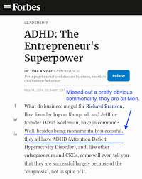
Recognize critical role of SMEs and entrepreneurs
SMEs are the backbone of the Canadian economy (99.7% of businesses employing 63.8% of the workforce)
Entrepreneurship is a legitimate pathway
SMEs are well-positioned to advance disability inclusion due to their smaller size and ability to establish closer relationships with employees
Many SMEs do not know where to start and are focused on day-to-day operations, postponing planning accessibility strategies
SMEs may perceive cost and lack of internal organizational infrastructure as barriers to accommodation and accessibility
Need to develop strategies tailored to their specific organizational context, size, industry, and workforce
Forbes
Notes:
Sources:
BDC. (2025). 10 things you (probably) didn’t know about Canadian small businesses. https://www.bdc.ca/en/articles-tools/business-strategy-planning/manage-business/10-things-didnt-know-canadian-sme#:~:text=As%20of%202022%2C%20SMEs%20are,in%20the%20private%20labour%20force.
Lindsay, S., Cagliostro, E., Albarico, M., Mortaji, N., & Karon, L. (2018). A systematic review of the benefits of hiring people with disabilities. Journal of Occupational Rehabilitation, 28(4), 634-655. https://doi.org/10.1007/s10926-018-9756-z
Molyneux, C. (2021). Disabled people, work, and small-medium-size enterprises (SMEs). [Doctoral dissertation, Lancaster University]. https://eprints.lancs.ac.uk/id/eprint/159921/1/2021molyneuxphd.pdf
Mo, G., Cukier, W., Atputharajah, A., Boase, M., & Hon, H. (2020, October). Differential impacts during COVID-19 in Canada: A look at diverse individuals and their businesses. Canadian Public Policy, 46(S3), S261-S271. https://doi.org/10.3138/cpp.2020-072 69
Diversity Institute. (2025). Piloting accessibility diversity assessment tool: supporting employees with disabilities in SMEs. https://www.torontomu.ca/content/dam/diversity/reports/accessibility-dat/Piloting%20Accessibility%20Diversity%20Assessment%20Tool-v4%20(1).pdf
Sources:
Diversity Institute. (2024). Pilot Disability Assessment Tool. Internal
Disability:IN. (n.d.). Diversify your supply chain with disability-owned business enterprises. https://workwithoutlimits.org/wp-content/uploads/2023/01/2019-SupplierDiversityvCorporation.pdf
DisabilityCan. (n.d.). Disability Works: Disability Inclusion Improves Supply Chain Performance. https://diversitycan.com/web/Article?id=Disability-Iclusio-Imroves-Suly-Chai-erformace-2620
Inclusive Workplace and Supply Council of Canada. (n.d.). Becoming a Certified Supplier. https://iwscc.ca/supplier/
Lafrance-Cooke, A., Bemrose, R. (2022, January 18). Business ownership among persons with disabilities in Canada. Statistics Canada. https://www150.statcan.gc.ca/n1/pub/36-28-0001/2021012/article/00004-eng.htm

Slide 34
Employer awareness and tools
Financial Incentives & Support Mechanisms
Tools & Resources
Funding, tax credits, reimbursement, financial support for recruitment and onboarding support
Toolkits, Training Programs, Assessment Frameworks, Universal Design Principles, Standards
Fill Labour & Skills Shortages
Voluntary Codes & Initiatives
Persons with disabilities are an untapped talent pool that can help fill labour shortages
Proactive approach and non-legislative means for adherence to standards and best practice sharing
Notes:
Nagtegaal R, de Boer N, van Berkel R, Derks B, Tummers L. Why Do Employers (Fail to) Hire People with Disabilities? A Systematic Review of Capabilities, Opportunities and Motivations. J Occup Rehabil. 2023 Jun;33(2):329-340. doi: 10.1007/s10926-022-10076-1.
Kaye HS, Jans LH, Jones EC. Why don't employers hire and retain workers with disabilities? J Occup Rehabil. 2011 Dec;21(4):526-36. doi: 10.1007/s10926-011-9302-8
Cukier, W., Jahangir, Y-T., & Hinz, F. (2023). Engaging Employers in Activating Persons with Disabilities. Diversity Institute, Internal
Return on Disability. (2023). Employment of Persons with Disabilities in Small and Medium-sized Enterprises. https://www.rod-group.com/research-insights/employment-of-persons-with-disabilities-in-small-and-medium-sized-enterprises
Harvard Business Review. (2023, September 12). People with Disabilities Are an Untapped Talent Pool. https://hbr.org/podcast/2023/09/people-with-disabilities-are-an-untapped-talent-pool
ESDC. ( ). Employment Strategies for Canadians. https://www.canada.ca/en/employment-social-development/programs/disability-inclusion-action-plan/employment-strategy.html

Slide 35

Organizational Level: The Accessibility Diversity Assessment Tool (DAT)
Governance, Leadership & Strategy
Human Resources Processes
Values & Culture
Measurement & Tracking of EDI
Diversity across the Value Chain
Outreach & Expanding the Pool
Notes:
Sources:
Diversity Institute. (2024). Pilot Disability Assessment Tool. https://www.torontomu.ca/content/dam/diversity/reports/accessibility-dat/Piloting%20Accessibility%20Diversity%20Assessment%20Tool-v4%20(1).pdf

Slide 36
Governance, leadership and strategy
Set tone from the top: promoting persons living with disabilities into leadership roles can significantly improve accommodations and employer inclusivity
Ensures diverse perspectives are considered in decision-making
Naturally increases disability awareness throughout the workplace, leading to improve implementation of accessibility through processes and organizational culture
Signals to the rest of the organization that accessibility and inclusion of persons living with disabilities is a strategic priority, activating employees to recognize, engage and support policies
A study of 33 global C-suite leaders found that 78% of disability inclusive executives had personal connections to disability
Create leadership development tracks to harness the potential of PwDs and bolster talent pipelines for promotional opportunities
Notes:
Sources:
Sinclair, V., Bath, R., Renaud, L., Willson, M., Ali, S., & Karusala, C. (2024). Awareness to action: How employers can embrace disability inclusion in the workplace. Canadian Council on Rehabilitation and Work, INNoVA. https://www.google.ca/url?sa=t&rct=j&q=&esrc=s&source=web&cd=&ved=2ahUKEwjPzeW8r5mMAxUIm4kEHTneOkwQFnoECBcQAQ&url=https%3A%2F%2Fccrw.org%2Fwp-content%2Fuploads%2F2024%2F11%2FAwareness-to-action-How-employers-can-embrace-disability-inclusion-in-the-workplace_CCRW_Trends-Report-2024_PLAIN-TEXT.docx&usg=AOvVaw3IccrtGryGBEaIKpa35i2-&opi=89978449
Diversity Institute. (2024). Pilot Disability Assessment Tool. Internal
Gulseren, D-B., Samosh, D-S., Kulkarni, M., Glumann, N., Hancock, A-J., & Mihelcic, C-A. (2023). Theoretical and Empirical Advancements in Research on Disability and Leadership. Academy of Management. https://doi.org/10.5465/AMPROC.2023.14429symposium
Valuable 500. (2025). Unlocking Disability-Inclusive Leadership. https://www.thevaluable500.com/wp-content/uploads/2024/12/Inclusive-Leadership-Whitepaper-remediated-version.pdf

Slide 37
Human resources processes
Redesign human resource processes from an accessibility perspective:
recruitment, selection, training, retention, promotion, and departure
Ensure HR processes build in opportunities for employees to request support without discrimination, and promote equitable opportunities
Shown to reduce biases and enhance professional development of Persons living with disabilities
A meta-analysis of studies found that HR professionals were less likely to hire applicants with disabilities compared to those without
Once employed, they received more favourable performance evaluations, suggesting paternalistic biases that underestimate their competence during recruitment
Develop standardized and structured selection processes, individualized training/coaching/mentoring, unconscious bias training, and inclusive appraisal systems that recognize contributions of PwDs
Notes:
Sources:
Diversity Institute. (2024). Pilot Disability Assessment Tool. Internal
Schloemer-Jarvis, A., Bader, B., & Böhm, S. A. (2021). The role of human resource practices for including persons with disabilities in the workforce: a systematic literature review. The International Journal of Human Resource Management, 33(1), 45–98. https://doi.org/10.1080/09585192.2021.1996433
Karpur, A., VanLooy, S-A., & Bruyère, S-M. (2014) Employer Practices for Employment of People With Disabilities: A Literature Scoping Review. Rehabilitation Research, Policy, and Education, 28(4). https://connect.springerpub.com/highwire_display/entity_view/node/77119/full
ESDC. (2024). Disability inclusion action plan: what we've accomplished, 2024 annual update. Government of Canada. https://www.canada.ca/en/employment-social-development/programs/disability-inclusion-action-plan/reports/annual-2024.html
Valuable 500. (2025). Unlocking Disability-Inclusive Leadership. https://www.thevaluable500.com/wp-content/uploads/2024/12/Inclusive-Leadership-Whitepaper-remediated-version.pdf

Slide 38
Values and culture
Embed inclusion and accessibility as a core value
“Tone from the top”, policies, embedded values
A study by Accenture found that organizations and employers leading in disability inclusion earned 1.6x more revenue and 2.6x more net income compared to their peers
Organizations employing PwDs report 72% higher retention rates among employees with disabilities, attributed to inclusive cultures and tailored accommodations
Emphasize and implement comprehensive accessibility policies, long-term plans, standards, adaptive accessibility solutions, and support groups (ERGs)
Notes:
Sources:
Diversity Institute. (2024). Pilot Disability Assessment Tool. Internal
Blanck, P. (2020). Disability Inclusive Employment and the Accommodation Principle: Emerging Issues in Research, Policy, and Law. Journal of Occupational Rehabilitation, 30, 505-510. https://doi.org/10.1007/s10926-020-09940-9
Accenture. (2024). The Disability Inclusion Imperative. https://www.accenture.com/content/dam/accenture/final/accenture-com/document-2/Disability-Inclusion-Report-Business-Imperative.pdf
Kaufmann, L., Hsiao-Ying Chang, V., Kuxmykanthan, L., Sanscartier, S., Lord, C., & Nguyen, C. (2025). Employ Ability: Enhancing employer capacity to recruit and retain diverse people with disabilities. SRDC-SRSA. https://www.srdc.org/wp-content/uploads/2023/08/Employ-Ability-Employer-Guide_Jan2025.pdf

Slide 39
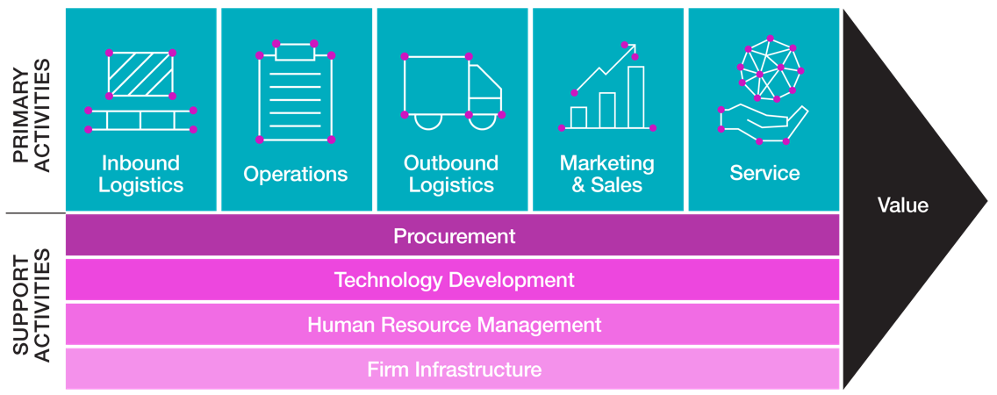
Mainstreaming Diversity Through the Value Chain

Slide 40









“What Gets Measured Gets Done”
Example of an Organization with Level 4 Average
Outreach & Expanding the Pool
Governance & Leadership
Levels
1
Minimal & Regulatory Compliance
5
4
2
3
Value Chain
2
1
Measurement & Tracking
3
Foundational Demonstration
4
Advanced Implementation
5
Strategic Integration
Culture
HR Practices

Slide 41
Partnerships and Outreach
Consider accessibility and inclusion in government relations, philanthropy and partnerships
Bring an intersectional lens in dealing with equity deserving groups
Advocate for inclusive policies and standards
Create pathways to employment

Slide 42
Strategies to advance opportunities
Create leadership development tracks for PwD A study of 33 global C-suite leaders found that 78% of disability inclusive executives had personal connections to disability | Standardize hiring and promotion processes; provide training & mentorship; unconscious bias training A meta-analysis of studies found that HR professionals were less likely to hire applicants with disabilities compared to those without | Implement accessibility policies, long-term plans, standards, adaptive accessibility solutions, and ERGs Organizations leading in disability inclusion earned 1.6x more revenue and 2.6x more net income compared to their peers
What gets measured gets done Inclusion allows disclosure & better support. BCG found companies believed 4-7% of employees had a disability. In reality, it was closer to 25%. Accenture: 76% of employees and 80% of executives with a disability don’t fully disclose | Diversifying supply chain supports businesses run by PwDs leading to potential partnerships that can help transfer and create actionable strategies by cross-sharing of values, practices and policies E.g. Inclusive Workplace and Supply Council of Canada | Work with stakeholders (advocacy groups, government, educational institutions, training and employment support orgs) and build partnerships to unlock the potential of PwD talent pool
Notes:
Sources:
Sinclair, V., Bath, R., Renaud, L., Willson, M., Ali, S., & Karusala, C. (2024). Awareness to action: How employers can embrace disability inclusion in the workplace. Canadian Council on Rehabilitation and Work, INNoVA. https://www.google.ca/url?sa=t&rct=j&q=&esrc=s&source=web&cd=&ved=2ahUKEwjPzeW8r5mMAxUIm4kEHTneOkwQFnoECBcQAQ&url=https%3A%2F%2Fccrw.org%2Fwp-content%2Fuploads%2F2024%2F11%2FAwareness-to-action-How-employers-can-embrace-disability-inclusion-in-the-workplace_CCRW_Trends-Report-2024_PLAIN-TEXT.docx&usg=AOvVaw3IccrtGryGBEaIKpa35i2-&opi=89978449
Diversity Institute. (2024). Pilot Disability Assessment Tool. Internal
Gulseren, D-B., Samosh, D-S., Kulkarni, M., Glumann, N., Hancock, A-J., & Mihelcic, C-A. (2023). Theoretical and Empirical Advancements in Research on Disability and Leadership. Academy of Management. https://doi.org/10.5465/AMPROC.2023.14429symposium
Valuable 500. (2025). Unlocking Disability-Inclusive Leadership. https://www.thevaluable500.com/wp-content/uploads/2024/12/Inclusive-Leadership-Whitepaper-remediated-version.pdf
Human Resources Processes
Standardized and structured selection processes, such as structured interviews and objective benchmarks, were found to reduce biases against PwDs. However, many employers lacked knowledge or compliance with legal standards for inclusive recruitment
PWD were less likely to participate in formal training and mentoring programs compared to their peers. However, practices like individualized training, job coaching, and mentoring systems showed potential for enhancing PwD's vocational development
Few studies addressed this area, but the research highlighted the need for inclusive appraisal systems that recognize the unique contributions of PwD
A meta-analysis of studies related to HR practices when hiring persons living with disabilities found that HR professionals were less likely to hire applicants with disabilities compared to those without
However, once employed, they received more favourable performance evaluations, suggesting paternalistic biases that underestimate their competence during recruitment
Evidence-based HR interventions must be integrated in all processes to prevent and counteract this form of behaviour
For example, the Canadian government has hired over 4,000 PwDs since 2022 (toward a goal of 5,000) through the modernization of the Employment Equity Act (EEA) aligning disability definitions with the Accessible Canada Act to improve federal hiring of PwDs by reforming HR practices and policies as a part of their accessibility strategy
IBM’s accessibility policies and training program reduced perceived accommodation costs, improved retention, and decreased accommodation-related delays by 40%
Sources:
Diversity Institute. (2024). Pilot Disability Assessment Tool. Internal
Schloemer-Jarvis, A., Bader, B., & Böhm, S. A. (2021). The role of human resource practices for including persons with disabilities in the workforce: a systematic literature review. The International Journal of Human Resource Management, 33(1), 45–98. https://doi.org/10.1080/09585192.2021.1996433
Karpur, A., VanLooy, S-A., & Bruyère, S-M. (2014) Employer Practices for Employment of People With Disabilities: A Literature Scoping Review. Rehabilitation Research, Policy, and Education, 28(4). https://connect.springerpub.com/highwire_display/entity_view/node/77119/full
ESDC. (2024). Disability inclusion action plan: what we've accomplished, 2024 annual update. Government of Canada. https://www.canada.ca/en/employment-social-development/programs/disability-inclusion-action-plan/reports/annual-2024.html
Valuable 500. (2025). Unlocking Disability-Inclusive Leadership. https://www.thevaluable500.com/wp-content/uploads/2024/12/Inclusive-Leadership-Whitepaper-remediated-version.pdf
Values and Culture
Point one: Accenture 2024
Transforming organizational values and culture by embedding inclusion and accessibility not only improves workplace environment for PwDs but enhances overall organizational performance and improves engagement between employees without and those with disabilities
Drives a more concerted effort by involving all personnel across business functions and interconnected organizational mechanisms, orienting inclusive strategies targeting PwDs
A study by Accenture found that organizations and employers leading in disability inclusion earned 1.6 times more revenue and 2.6 times more net income compared to their peers, underscoring an economic advantage and clear business case for inclusive practices
A culture of inclusion have shown to increase a sense of belongingness leading to improved productivity, morale, and tenure of PwDs
A culture of accommodation creates far-reaching, positive ripple effects for all employees:
This approach fosters a workplace climate of flexibility and support, leading to more effective and innovative accommodations, producing productive outcomes for both employees with disabilities and the entire workforce
Employee Resource Groups provide support and feedback platforms while creating safe spaces for PwDs to connect and for others to learn
ERG insights at some firms led to redesigned recruitment portals, increasing applications from PwDs by 34%
Organizations employing PwDs report 72% higher retention rates among employees with disabilities, attributed to inclusive cultures and tailored accommodations
Sources:
Accenture. (2024). The Disability Inclusion Imperative. https://www.accenture.com/content/dam/accenture/final/accenture-com/document-2/Disability-Inclusion-Report-Business-Imperative.pdf
Kaufmann, L., Hsiao-Ying Chang, V., Kuxmykanthan, L., Sanscartier, S., Lord, C., & Nguyen, C. (2025). Employ Ability: Enhancing employer capacity to recruit and retain diverse people with disabilities.
Diversity Institute. (2024). Pilot Disability Assessment Tool. Internal
Blanck, P. (2020). Disability Inclusive Employment and the Accommodation Principle: Emerging Issues in Research, Policy, and Law. Journal of Occupational Rehabilitation, 30, 505-510. https://doi.org/10.1007/s10926-020-09940-9
Kaufmann, L., Hsiao-Ying Chang, V., Kuxmykanthan, L., Sanscartier, S., Lord, C., & Nguyen, C. (2025). Employ Ability: Enhancing employer capacity to recruit and retain diverse people with disabilities. SRDC-SRSA. https://www.srdc.org/wp-content/uploads/2023/08/Employ-Ability-Employer-Guide_Jan2025.pdf
Measurement and Tracking
https://www.odenetwork.com/measuring-impact-7-key-metrics-for-assessing-the-success-of-disability-inclusion-in-your-business/
Value Chain
Consider disability-owned businesses in procurement processes
Improve product/service design and marketing for consumers with disabilities by collaborating with disability-owned businesses that can lead to increased engagement with disability community and market
Opens new market segments/niches to boost sales and create new profitability pathways
Suppliers with diversity offer unique insights into the needs and preferences of the disability community, enhancing understanding of diverse market segments and provides an opportunity to learn and improve workplace inclusivity and accessibility for employees with disabilities
Enhance overall supply chain performance and foster inclusivity through valuable partnerships that can create a stronger network which supports both disability-owned businesses and employees with disabilities
A study by Cargill in the US found that leading procurement organizations with higher adoption rates of supplier diversity programs generate 133% greater return on the cost of procurement compared to peers
It’s important for businesses to only support employees within their workforce but provide access to the economic mainstream of PwDs
Persons with disabilities are pushed and pulled into entrepreneurship
IWSCC (Inclusive Workplace and Supply Council of Canada) is an organization in Canada that certify businesses that are majority-owned (over 51%) and operated by persons with disabilities or Veterans
By prioritising organizations majority-owned or operated by persons with disabilities, you can support them by providing business opportunities to them
BenchSci and Cineflix: multi-year accessibility plans to target the needs of persons living with disabilities and incorporate them into their products and services
Adlib provides accessible telephone services and billing information and facilitate communication training for employees in the customer care division to create awareness on support for clients with disabilities
Sources:
Diversity Institute. (2024). Pilot Disability Assessment Tool. Internal
Disability:IN. (n.d.). Diversify your supply chain with disability-owned business enterprises. https://workwithoutlimits.org/wp-content/uploads/2023/01/2019-SupplierDiversityvCorporation.pdf
DisabilityCan. (n.d.). Disability Works: Disability Inclusion Improves Supply Chain Performance. https://diversitycan.com/web/Article?id=Disability-Iclusio-Imroves-Suly-Chai-erformace-2620
Inclusive Workplace and Supply Council of Canada. (n.d.). Becoming a Certified Supplier. https://iwscc.ca/supplier/
Lafrance-Cooke, A., Bemrose, R. (2022, January 18). Business ownership among persons with disabilities in Canada. Statistics Canada. https://www150.statcan.gc.ca/n1/pub/36-28-0001/2021012/article/00004-eng.htm
Outreach and expanding the pool
Employers can work with external organizations, such as advocacy groups like the Discover Ability Network (DAN), which are specialized and have the expertise to help them increase their exposure to persons living with disabilities for recruitment and create inclusive strategies through free training, virtual workshops, and learning modules that enhance hiring opportunities for persons living with disabilities within their business
Collaboration with organizations like the Diversity Institute and Future Skills Centre skills programs to access talent pools
Disability:IN worked with over 500 corporations and 650 universities to facilitate connections between employers and talented individuals with disabilities
Invest in community engagement and workforce development to establish connections with employment bridging programs and organizations which facilitate it as well as provide targeted training opportunities to grow the talent pool and increase recruitment of persons living with disabilities
As a significantly underemployed demographic, their skills underutilization represents a vast, untapped talent pool that can contribute to organizational performance and help employers, especially SMEs, address skills and labour shortages
Improve access to a wider range of skills, experiences and perspectives by expanding talent searches
The population of persons living with disabilities is growing along with labour demands and the overall economy, to stay boost competitiveness in evolving markets by expanding the talent pipeline and provide pathways to employment opportunities and labour market integration
Sources:
Diversity Institute. (2024). Pilot Disability Assessment Tool. Internal
Pulsifer, H. (2023, September 27). The Disability Talent Pool Is a Gold Mine: Here Are Some Ways to Tap It. LinkedIn, Customer Inclusion Disability Community. https://www.linkedin.com/pulse/disability-talent-pool-gold-mine-here-some-ways-tap-hale-pulsifer
Kaufmann, L., Hsiao-Ying Chang, V., Kuxmykanthan, L., Sanscartier, S., Lord, C., & Nguyen, C. (2025). Employ Ability: Enhancing employer capacity to recruit and retain diverse people with disabilities. SRDC-SRSA. https://www.srdc.org/wp-content/uploads/2023/08/Employ-Ability-Employer-Guide_Jan2025.pdf

Slide 43

Thank You
torontomu.ca/diversity
diversityinstitute@torontomu.ca
@TorontoMetDI
416-979-5000, ext. 556740
Copyright © Diversity Institute, 2025

Slide 44

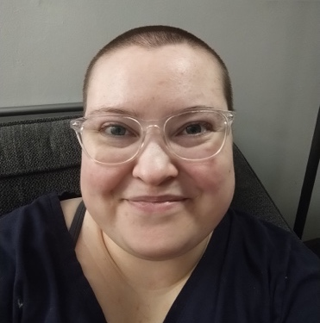
March of Dimes Canada
Charlotte Buttle, Research and Evaluation Associate, March of Dimes Canada
Hedge Thompson, Project Committee Member

Slide 45
Creating Inclusive Employment
Addressing Barriers to Digital Skills & Tech-Enabled Jobs in Canada – Insights from Young People with Disabilities
Charlotte Buttle & Hedgerow Thompson
March of Dimes Canada
Knowledge to Action Team

Slide 46

March of Dimes Canada
MODC is a national charity with a 70-year history of helping people with disabilities achieve independence, dignity, and autonomy
Driven by 2,400 dedicated employees and 500 volunteers, MODC supports around 30,000 service users
Last fiscal year, over 3,000 people received digital technology skills training and support
Notes:
Who we are

Slide 47


The ‘Creating Inclusive Employment’ Project
How can we create barrier-free, non-traditional digital skill development pathways for young people with disabilities in Canada?

Slide 48

Creating Inclusive Employment
World Café
Focus Group with 3 breakout sessions
10 participants including young adults with disabilities and sector experts
Notes:
Intro to the project and methods

Slide 49
Why digital skills matter for employment: Insights from the Community

Slide 50

Digital skills are essential for both life and work, but access is uneven.
6

Slide 51

Digital skills are Assumed and not trained for
7

Slide 52

Applying, Interviewing, and onboarding often require Baseline Digital Literacy
8

Slide 53
Strategies for Employers
Build inclusive hiring practices
Invest in your employees
Build inclusive workplace culture
Ask for help

Slide 54

Conclusion
Utilize community supports to bridge gaps
Employers play a role in providing training for digital and technical skills
More financial and social supports for young people with disabilities
10
Notes:
Brief summary of key results and recommendations
I like to include a TLDR/key takeaway

Slide 55

Thank You!

Slide 56


LiveWorkPlay
Rebecca Coxon, Team Lead for Employment Ontario and the Interim Volunteer Manager, LiveWorkPlay
Anna Nelson, Director of Employment Supports, LiveWorkPlay

Slide 57

Preparing for a Strong Start
Building employer capacity for disability inclusion in the workplace
57

Slide 58
LiveWorkPlay’s mission
LiveWorkPlay helps the community welcome and include people with intellectual disabilities, autistic persons, and individuals with a dual diagnosis to live, work, and play as valued citizens.
58

Slide 59
Current Reality: Under-Representation
79.6% Employment rates for persons without disabilities
65.5% Employment rates for the overall disability population
25% Employment rates for people with an intellectual disabilities
59

Slide 60
LiveWorkPlay’s Inclusive Employment Supports Model©
1
Recruitment & Selection
2
Onboarding & Training Plan Development
3
Retention & Ongoing Consultation
60

Slide 61
Focus: Onboarding and Training Plan
Supporting a new job start before the first day
Preparing employee and employer for a successful start
Aim to decrease reliance on third-party support (such as job coaches)
61

Slide 62
Practical Implementation
Service provider and employer work together to review standard onboarding process
Discuss accommodations and implementation
Common accommodations
Check lists
Demonstrative learning
Written or video instructions
Employer delivers onboarding
Ongoing collaboration between employee, employer and service provider
62

Slide 63
Onboarding and Training Plan development
Examples: what the new hire needs to know | Examples: what the supervisor(s) need to know
Practical reminders for getting to and from work (public transportation plan, calendar notifications, other) | Practical tips about how the new hire learns and how they best receive information
Dress code of the workplace (this can shift and change situationally, and some work may be needed to ensure they have everything they need) | Accommodations the new hire needs, and how to build those into the workplace culture (who else needs to know about it?)
How do they call in sick? | Strengths of the new hire
What will the first day/week look like? | What else can we anticipate that the supervisors will need s to know?
Reminder of any strategies they use if feeling overwhelmed, are not clear on a task etc.
63

Slide 64
Training Plan: Four guiding principles
Individualized
(Person-Centered)
Prep before first day of work
Collaborate with employer
Equip employer to take lead on supporting employee
64

Slide 65
Thank You! Questions?
Anna@LiveWorkPlay.ca
Rebecca@LiveWorkPlay.ca
65

Slide 66


Holland Bloorview Kids Rehabilitation Hospital
Laura Bowman, Project Manager, Research and Evaluation, Holland Bloorview Kids Rehabilitation Hospital
Carolyn McDougall, Manager, Employment Pathways and Ontario/Canada coordinator-Project SEARCH, Holland Bloorview Kids Rehabilitation Hospital

Slide 67

Including employers: Meaningfully including employers in the discussion about building disability-inclusive workplaces
Carolyn McDougall & Laura Bowman
October 7, 2025

Slide 68


Acknowledgements
The Employment Pathways clinical work is generously funded by donors to Holland Bloorview Kids Rehabilitation Hospital Foundation including the Azrieli Foundation (2022-2027), the Slaight Family Foundation (2025-2029) the RBC Foundation in support of RBC Future Launch (2021-2026), and the Peter Gilgan Foundation (2016-2023).
Our research and evaluation work is generously funded by donors to Holland Bloorview Kids Rehabilitation Hospital Foundation including the Azrieli Foundation, as well as funding from the Government of Ontario.

Slide 69




Why invest in inclusive employment?
1 in 4 Ontarians have a disability
70% of disabilities are invisible
Companies that invested in accessible employment practices report increases in key performance areas
90% of workers with disabilities scored average/ above average for job performance
All employees are required to meet bona fide job requirements
Companies want to promote disability-inclusive employment, but need “know-how” guidance.
$
The average cost of an accommodation is $500
?

Slide 70
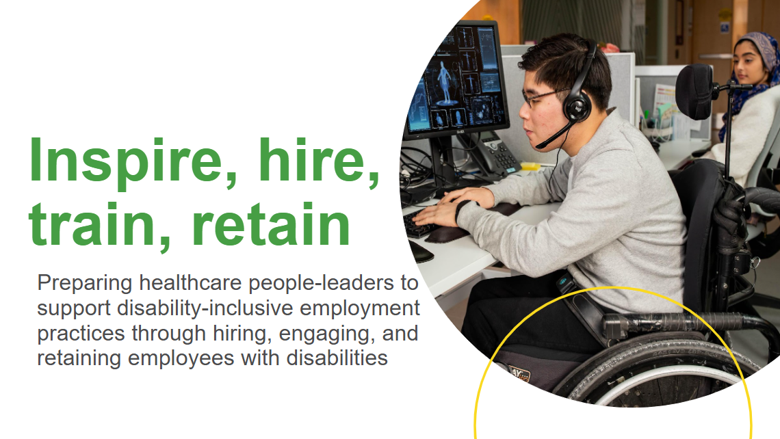

How to ‘do’ a disability-inclusive workplace
Inspire, Hire, Train, Retain (IHTR)
Project SEARCH: Realizing Employment Potential
WHY: Education/knowledge
WHO: Sector specific (by and for health care; aimed at people leaders within an organization
WHAT: Disability-inclusive workplace training
FOCUS: strategy and practice
WHY: Building local/regional talent pipeline
WHO: Broad sectors, specifically with workers with intellectual/developmental disabilities
WHAT: Disability-specific talent acquisition and exploration
FOCUS: hiring and talent pipeline

Slide 71
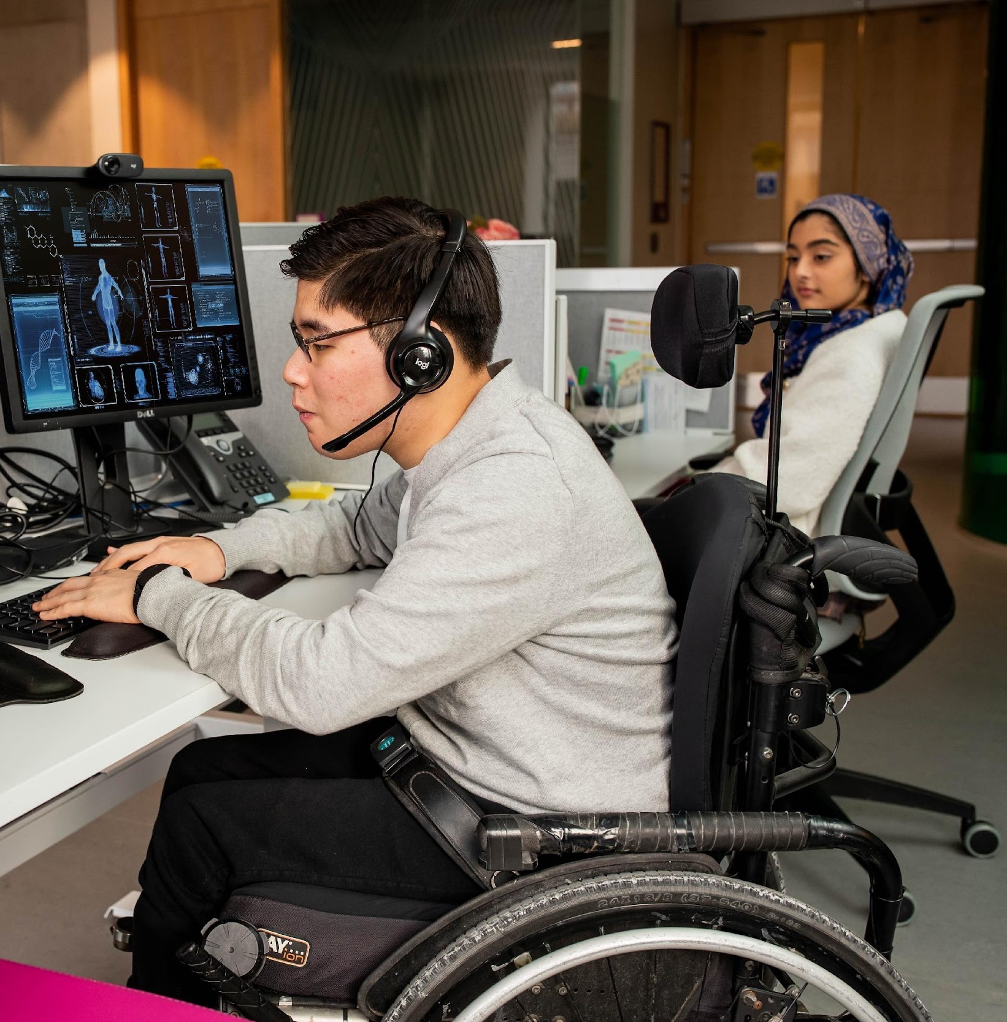
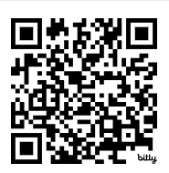
Inspire, hire, train, retain
Preparing healthcare people-leaders to support disability-inclusive employment practices through hiring, engaging, and retaining employees with disabilities

Slide 72
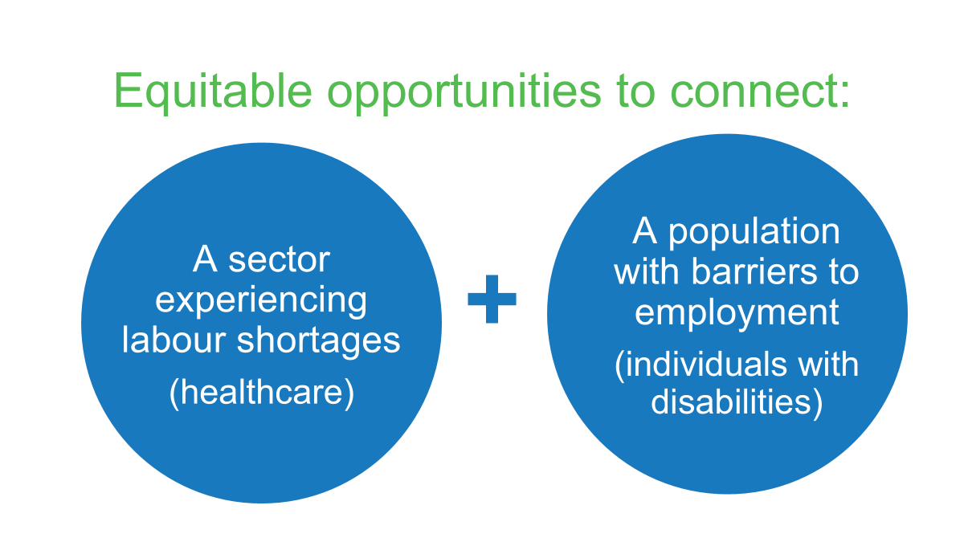


Inspire, Hire, Train, Retain (IHTR)
Goal: prepare health-care people-leaders to hire, engage, and retain workers with disabilities by increasing:
knowledge on accessibility
and
confidence for inclusion

Slide 73
IHTR creation process
Co-design of sector specific project, products, resources →
Primarily existing resources from reliable sources
All linked to the original sources for further learning
All tailored to an Ontario health care context
Uses a champion trainer model to promote internal accountability
Research & KMb
HC employees with disabilities
Health care:
HR, OD&L
occ health
managers
senior leaders
Employment service providers

Slide 74

IHTR products
Website: French and English resources
Implementation and facilitation guides
Editable IHTR template and train-the-trainer resources
Tip Sheets and worksheets
Healthcare-based case examples
Lived experience case and video examples

Slide 75
Outcomes and feedback
All 9 health care champion organizations to maintain group dedicated to disability-inclusive employment.
Champions reported organizational next steps as a direct result of participation in IHTR, including:
SickKids: expand inclusive recruitment pathway, explore partnership with Jobs Ability, incorporated JDAPT into practice
Norfolk & West Haldiman General Hospitals: review policies & job postings for accessibility, incorporate IHTR as part of annual new leadership training, implement IHTR as IDEA initiative
Holland Bloorview: Incorporate IHTR into onboarding and staff training, connected with OCTC
Halton Healthcare: Incorporate IHTR into onboarding and staff training
“This session was framed in such a supportive way that gives me courage to be more open in communicating about this topic in both advocating for it and challenging scenarios where I feel do not align with us being an anchor organization for inclusive employment.”
“Had I not gone to the presentation, I wouldn’t have known, and now have that free, local resource to assist HR to accommodate those with disabilities who are already in the building - that’s dollars and cents"

Slide 76
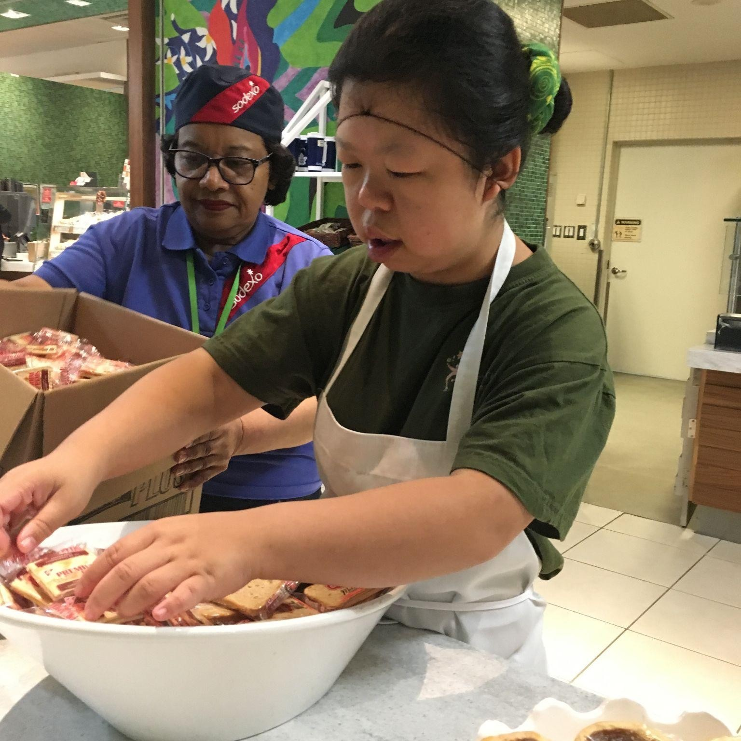
Project SEARCH Ontario:
Realizing Employment Potential
ProjectSEARCHCanada.ca | Linktr.ee/ProjectSEARCHCanada

Slide 77

Project SEARCH programs change lives by training and connecting youth with disabilities to quality employment.
27 sites-ON
65% employment
2x Canadian average*
Our “Realizing Employment Potential” strategy will expand the numbers and diversity of employers hiring Project SEARCH talent - locally and in regions across Ontario.
21
average hours/week
$18.70
/hour 2022/23

Slide 78

Overview 2025-2029
CO-DESIGN PILOTS
Local team
WES
Activity examples
Marketing & engagement materials
Outreach & development - regional employer relationships ⇒ hiring pathways that multiple sites can leverage
Business engagement events
Learning system: Illustrate, summarize & share PS-ON job development best practices, local strengths, employer info
Collaborate on job search and employer engagement
Learn & share
Data Practices Knowledge

Slide 79

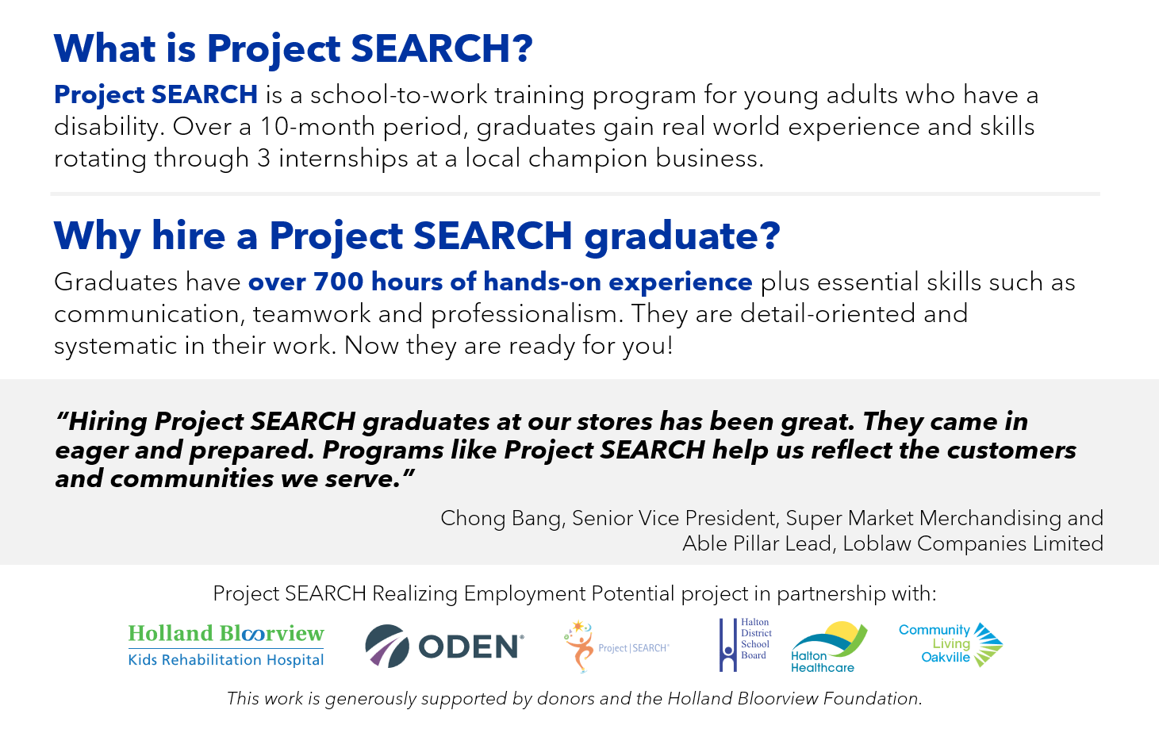

Slide 80
Illustration
ENGAGE LOCALLY
Introduce Learn Match Support
REPEAT & SCALE
Locally, regionally
Employer
GENERALIZE LEARNING
Success factors - employer, employee & ESP perspectives

Slide 81
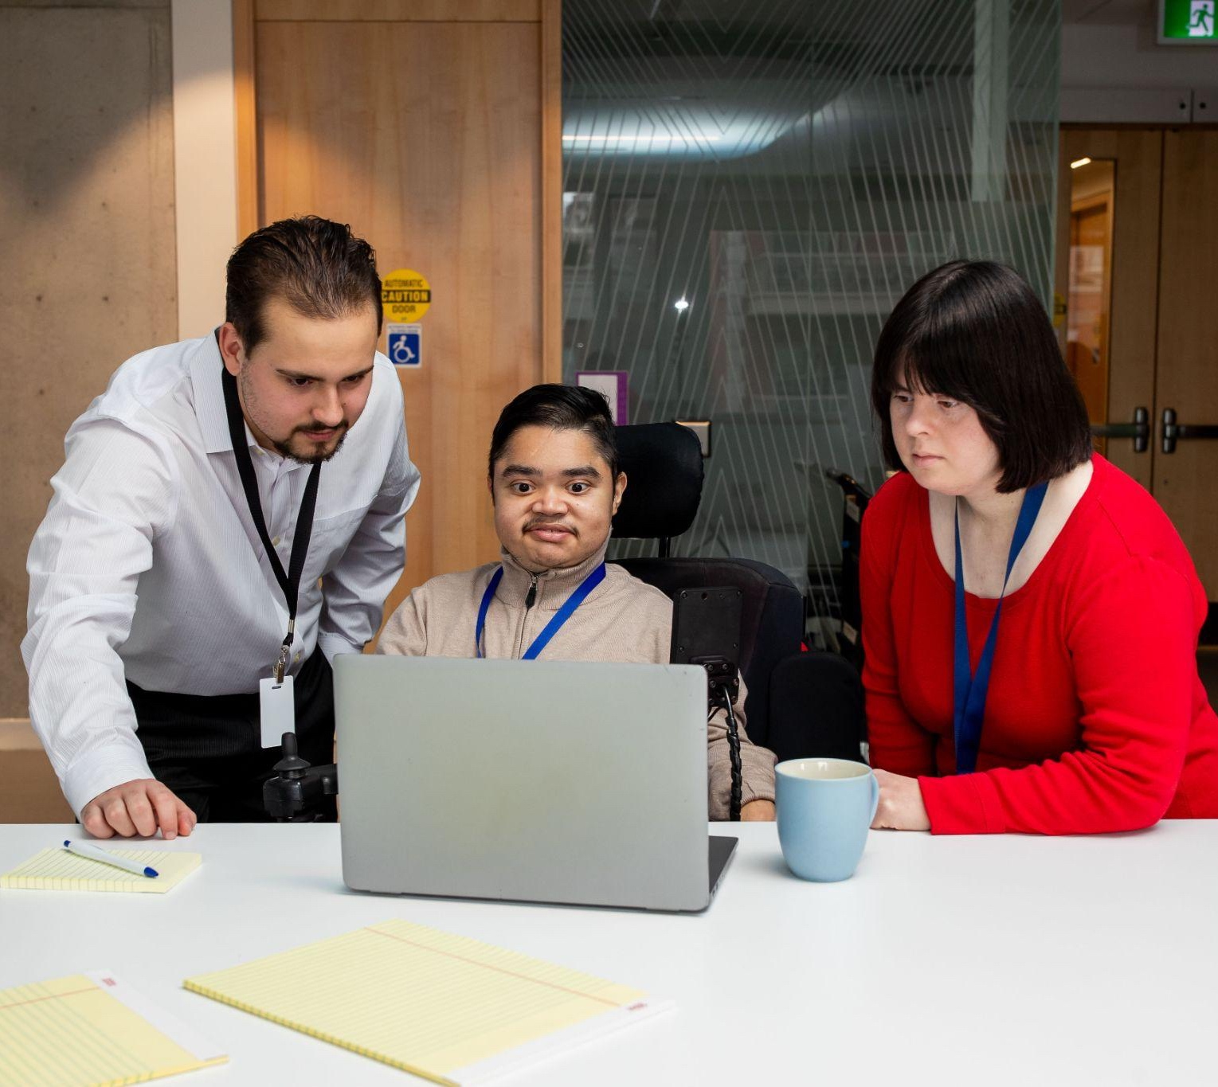
A final word
Disability-inclusion is an ongoing effort.
Do not let perfection impede your progress

Slide 82

Youth Employment Services (YES)
Gabriella Evans, Regional Manager, WorkAbility, Youth Employment Services (YES)

Slide 83


YES WORKABILITY
REDESIGNING THE WORKPLACE DNA

Slide 84

Youth Employment Services YES
Canada’s Employment Champion for Youth since 1968
YES served 14,336 youth in the last year and works with over 1000 employers throughout GTA and Canada
Has helped change the lives of hundreds of thousands of youth (16-30) by assisting them in finding employment and has an 85% success rate with ETI outcomes
Provides specialized programs to youth who self-identify with mental health concerns and coaches them once matched with an employer

Slide 85



YES WORKABILITY
A National Employer Education and Training Initiative
Designed to assist employers to create inclusive and accessible workplaces for persons with mental health disabilities.
Offers a range of free activities, including coaching, training, and hiring support.
Builds employer awareness, raises the profile of persons with mental health disabilities, and promotes the benefits of hiring, retaining and promoting persons with mental health disabilities.
So let's get started...

Slide 86


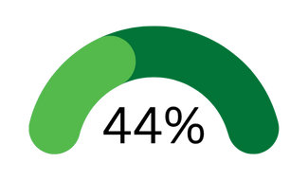
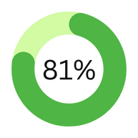
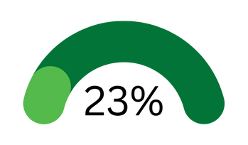
Mental Health in Canada
1 in 5 Canadians will have a mental health problem or illness in any given year
By the time Canadians reach 40 years of age, 1 in 2 have – or have had – a mental illness
of workers have indicated they have had mental health concerns
of workers reported, the pandemic negatively
impacted their mental health
of employees would talk about their mental illness with their employer

Slide 87

THE IMPACT OF MENTAL HEALTH IN OUR WORKPLACES
Burnout, Presenteeism, Absenteeism, Stress
500k missing work because of MH each week
$6.3 billion lost in productivity
43% of employers saw a rise in mental health accommodations since 2020

Slide 88



BENEFITS
Average or Higher Ratings in
As Well As
Attendance
Lower Rates of Absenteeism/Presenteeism
Punctuality
Motivation
Untapped Potential
Quality of Work
Altriusm
Retention

Slide 89

Mental Health Inclusion is not a barrier to businesses,
it is a strategy to helping your business overcome barriers

Slide 90
Employer Concern
Inclusive Response
Retention
1 in 4 businesses are struggling with retention
73% of employees and 81% of managers more likely to stay with mental health supports
Talent Transition 1 in 5 working aged Canadians are within retirement age
Limited Capacity Employers are currently responding to a job market with a 7.1% unemployment rate
More than half of Gen Z workers list a company’s mental health policies as important when selecting an employer
Employment service provides can reduce the time and communications of screening heavy volumes of applicants

Slide 91

When you create that safe space for employees, you’re going to get long lasting employees, who really care about the business and feel seen and heard
Karla Zlatarits
Manager of People & Culture, Pedalheads
WorkAbility Employer Partner

Slide 92




OUR SERVICES
Training Workshops
Job Fairs & Recruitment
Annual Roundtables
Toolkit
Access
In-person and virtual sessions designed for workplace leaders
Connecting employers with diverse and qualified candidates
Yearly roundtables to collaborate with thought leaders and businesses
Tools, resources,
and online, self-paced training modules

Slide 93
WORKABILITY RESOURCES FOR INCLUSIVE WORKPLACE DESIGN
Knowledge Gaps
Culture
Process & Policies
Responding to Concerns
Navigating Performance Concerns from a Mental Health Lens
Retention: Building a Workplace Where People Stay
Burnout
MH 101 for Workplace Leaders
Creating Organizational Capacity to Support Mental health
Inter-Generational Perspectives in the Workplace
Inclusive Interviewing
Onboarding with MH in Mind
Accommodations and Disclosures
Our Resources

Slide 94

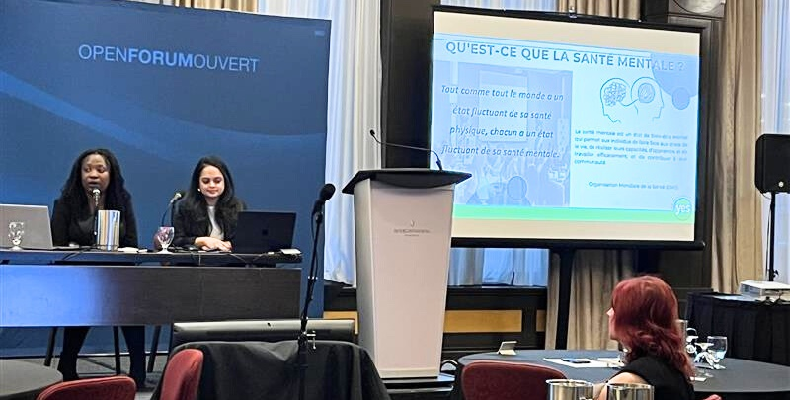
As of September 2025
467
Unique Organizations Engaged
20
Job Fairs Hosted
43
Info Sessions and Workshops Held
715
Individuals Attended Project Events
Private Training
Individual sessions for organizations including CanadaPost, CMHA Halton, TechInsights, The Toronto Zoo, Accenture, Ontario B Local, Sheraton Suites and more
Annual Roundtables
Annual Roundtable to bring together businesses and thought leaders on pressing issues and best practices
Notes:
Slides

Slide 95
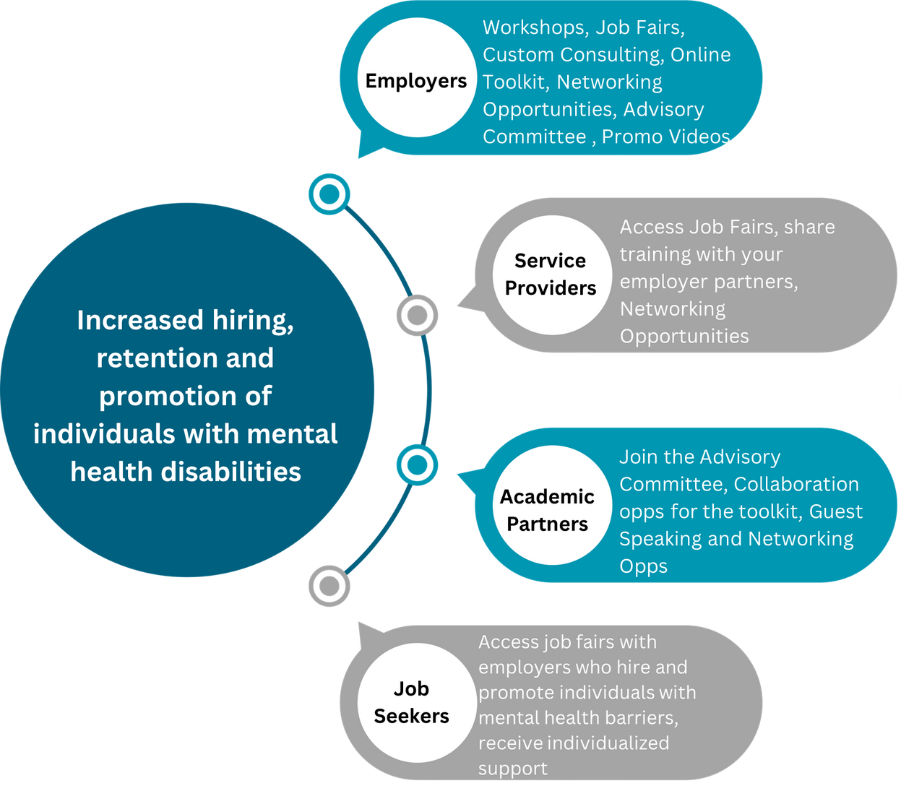
Partner with us

Slide 96

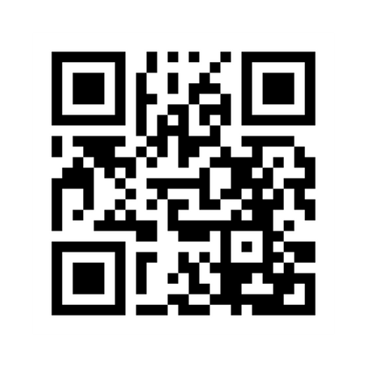
Thank you for Listening!
Visit us at yesworkability.ca or
email us at workability@yes.on.ca
for more information
Notes:
Questions?

Slide 97

Ontario Disability Employment Network (ODEN)
Bridgette Sterling, Disability Employment Inclusion Specialist, ODEN

Slide 98

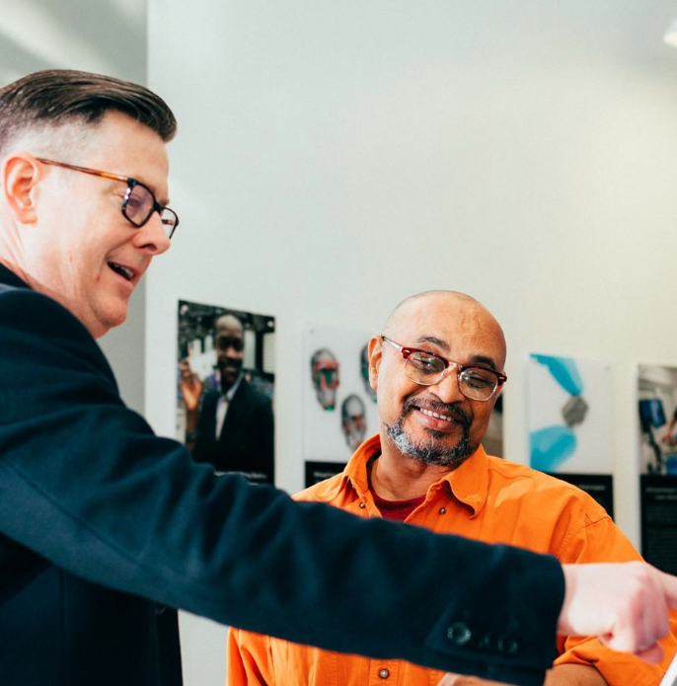


Designing Success:
ODEN’S Leadership in Disability Inclusive Hiring Through the OCTC Project Lessons
September 2025

Slide 99




The Opportunity
Ontario sectors lacked disability representation
Were at varying stages of their inclusion journey
Had unique capacity needs and staff scales
Kept within their sector, unaware of available supports

Slide 100
How might we sustainably advance disability inclusive hiring and equitable employment opportunities for people who have a disability across Ontario sectors facing labour challenges?
The Guiding Question

Slide 101






































The OCTC Project
Through strength-based collaborations, in 2023 ODEN established the Ontario Corporate Training Centre project to advance disability inclusive hiring. Running until Jan 2026, OCTC provides sector specific training, ESP relationships and services to businesses across the province.
Employers
Of Choice
Assess
Train
Support
Connect

Slide 102
























Provincial Impact, Local Approach
To effectively reach and understand the needs of businesses within the sectors, ODEN activated its network of Ontarian members, collaborators, associations, governmental and regional centres.
Community
Partners
Key community partnerships included:
Regional ESP members
Local business chambers
Sectoral associations
Workforce & Economic Development offices

Slide 103
ODEN Lessons Learned Through OCTC
1
Meet the business where they are on their inclusion journey and tailor as needed.
4
Build championship at the top early rather than bottom up or a well-meaning ERG.
2
Assume that not all businesses have the same capacity or resources.
5
Co-create the training implementation plan with an internal leader and tailor it.
3
Map disability inclusion to the business’s unique needs like retention or attraction.
6
Partner strategically locally to reach the businesses and understand their local context.

Slide 104
Case Study: ODEN and the CNE
1
Met the CNE where they were on their journey and tailored over the last 7 years
4
Built championship at the top, later becoming Business Champion to other communities
2
Assumed that they didn’t have the same capacity or resources as other businesses
5
Co-created the training implementation plan with leadership and scaffolded
3
Mapped disability inclusion to their unique labour needs of fast, high-volume hiring
6
Partnered strategically locally with ESPs, leading to 7 years of sustained recruitment of a labour force with 15% representation

Slide 105


To effectively sustain disability inclusion and employment opportunities for people who have a disability, it needs to be the imperative of the whole local community, not just it’s businesses.
Businesses
The Answer
Advocates
ESPs
Government
Chambers
Associations

Slide 106
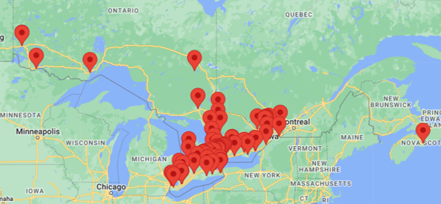
About ODEN
The Ontario Disability Employment Network (ODEN), is a network of Employment Service Providers united to increase the employment opportunities for people who have a disability.
Over 130 members are from every corner of the province and support people of all disability types.

Slide 107






ODEN’s Five Pillars of Engagement
The Mission: Increase Employment Opportunities for People Who Have a Disability
Businesses
& Employers
Employment Service Providers
Innovation & Promising Practices
Federal & Provincial Government
Families, Schools & Post Secondary

Slide 108






Let’s Connect!
@ODENetwork
Ontario Disability Employment Network
Ontario Disability Employment Network
@ODENetwork
www.odenetwork.com
Notes:
Questions & Discussion Portion

Slide 109


CASE/MentorAbility
Joanna Goode, Executive Director, Canadian Association for Supported Employment
Mary Beshai, Director - MentorAbility Canada, Canadian Association for Supported Employment

Slide 110
The Power of Mentorships
MentorAbility Moments Help
to Create Welcoming Workplaces
October 6, 2025
Joanna Goode,
Executive Director, CASE
Mary Beshai, Director, MentorAbility Canada

Slide 111

Agenda
About CASE
Mentoring moments matter
Businesses struggling to find/retain staff
Short-term mentorships can change workplaces and lives
MentorAbility

Slide 112
Canadian Association for Supported Employment (CASE)
National association that works with employment service providers, employers, industry associations, ​community partners, and other interest-holders toward employment inclusion of persons experiencing disability in Canada
For Service Providers: evidence-based learning offerings, resources, and community of practice​
For Employers: complimentary training and resources to strengthen workplace inclusion and equity​

Slide 113
Mentoring Moments Matter

Slide 114







The Six Elements of Career Mentoring
Reciprocal Learning
Career Exploration and Planning
Supporting Workplace Belonging
Career Conversations
Networking and Connecting
Learning and Upskilling

Slide 115

The Constellation of Career Mentoring
Career Mentoring Moments
Single or short-lived, but impactful interactions.
Natural Career Mentoring
Formal Career Mentoring
Mentoring relationships that develop organically through professional interactions with people in our natural work environments.
Structured mentoring programs with defined goals and durations. Mentors and mentees may not have known each other previously.

Slide 116
Businesses Struggling to Find/Retain Skilled Staff
Canadian business leaders are focused on:
Uncertainty around tariffs, inflation, the economy
Top 10 concerns include:
Costs
Recruiting and retaining skilled labour
Sources:
Bank of Canada - Business Outlook Survey - Second Quarter of 2025
Canadian Chamber of Commerce – Business Outlook Q2 Survey 2025
Notes:
Sources:
Bank of Canada - Business Outlook Survey—Second Quarter of 2025
https://www.bankofcanada.ca/2025/07/business-outlook-survey-second-quarter-of-2025/
Canadian Chamber of Commerce Business Outlook Q2 Survey 2025
https://businessdatalab.ca/wp-content/uploads/2025/06/2025_Q2_BIQ_EN_Final_PG_June-17.pdf

Slide 117
Gaps with Inclusion
Some companies eager to strengthen inclusion but:
“Disability” inclusion is missing
Aren’t confident about knowledge of disability
Some companies have integrated disability inclusion:
Not attracting the diverse talent they’re seeking
Looking for meaningful ways to support inclusion policies/procedures and to engage staff
“
“Sometimes it's easy for us to forget that people who work for us may have an invisible or a visible disability. We don't always realize the challenges that an individual can face.”
“
– Employer who participated in MentorAbility

Slide 118
MentorAbility Canada
Promotes recruitment, employment, and retention of persons experiencing disability
Facilitates and celebrates:
short (1-hour to 1-day) mentoring experiences
networking and learning events
social media campaigns​
Builds a body of evidence through research
Mentor Canada
The Conference Board of Canada
The Challenge Factory
All MentorAbility activities are complimentary. They can support your organization by engaging staff in a meaningful way on their disability awareness journey.

Slide 119
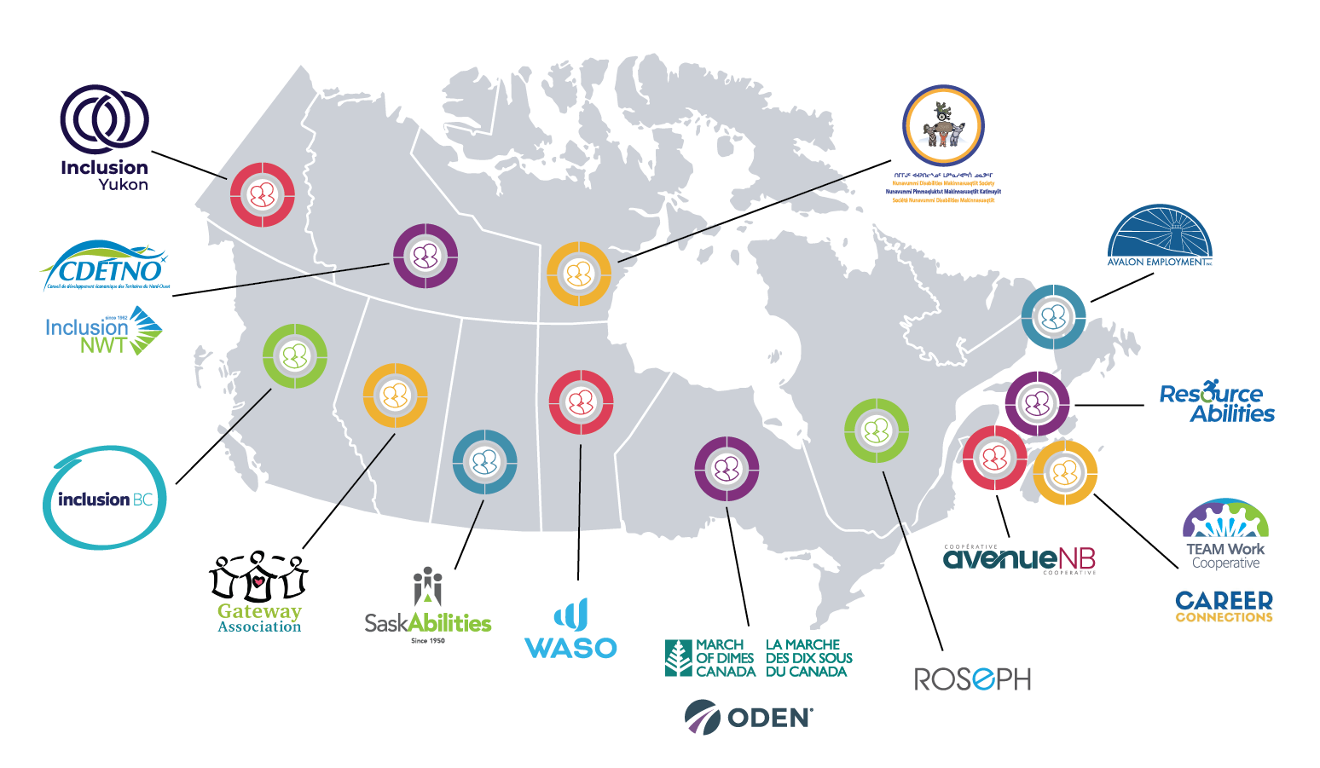


MentorAbility Canada
Strong network representing diverse communities and employers

Slide 120
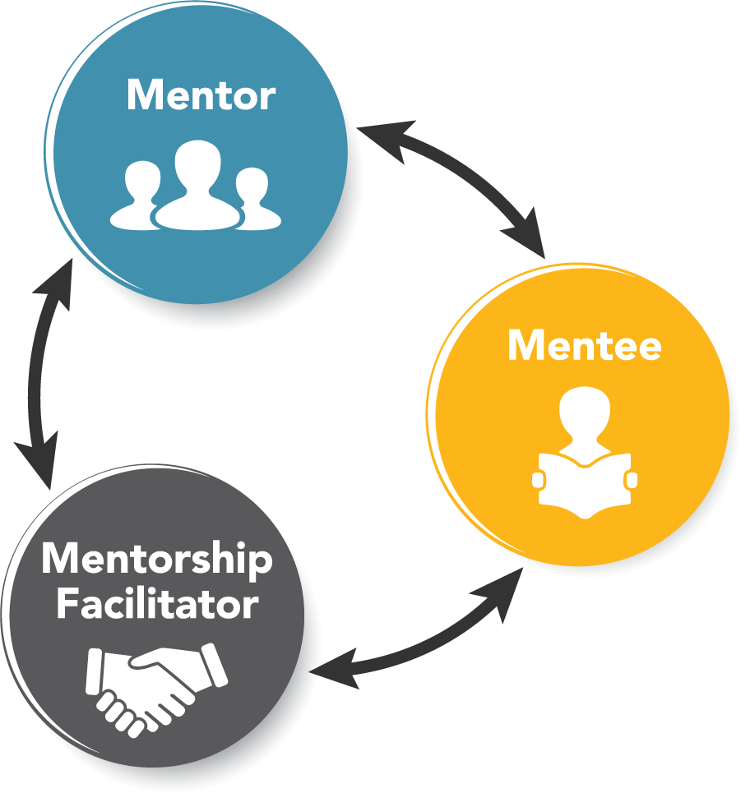



1,900 MentorAbility Mentorships since 2019
Every MentorAbility experience is unique.
The mentee, mentor, and mentorship facilitator each have a unique perspective to share and will all learn from the experience.
Notes:
Source:
Project Database

Slide 121
MentorAbility Canada – since 2023
1000+ mentors represent entrepreneurs and representatives from wide range of employers and sectors
900+ in-person and online events reaching 30,000+ employers,
service providers, community partners, job seekers, and
advocates
250+ mentorship facilitators signed up across Canada
“
“The MentorAbility program is very important to spread awareness to companies. There are many wonderful individuals that have many skills that companies could benefit from.”
“
– MentorAbility Mentor

Slide 122




Take the first step now − Contact MentorAbility
MentorAbility
Canada
MentorAbility Ontario
March of Dimes Canada
MentorAbility Ontario
ODEN
Thank you!

Slide 123
Table Talks Exercise

Slide 124
Break in Progress
Returning for Closing Keynote at 3:15 PM

Slide 125

Closing Keynote
Agnes McLachlan, Manager - Global Well-being, TELUS

Slide 126
TELUS Well-being and Health Services
Agnes McLachlan, Manager People and Culture – Global Well-being
For IDEA Symposium

Slide 127



Who is TELUS?
32,000 team members in 15 countries
Our team members hold roles in retail, contact centres, trades, office/admin, technology and healthcare
Making the future friendly
We give where we live
1.7B in philanthropy
2.2M volunteer days
A world leading communications technology firm
Canada’s largest healthcare IT provider, TELUS Health
One of the world’s largest agricultural technology companies, TELUS Agriculture & Consumer Goods

Slide 128



Our team
focused on keeping all team members healthy, well and able
People & Culture
Well-being Strategy
Mental health strategy
Health promotion & targeted support
Well-being & fitness centres
Employee & family assistance program
Well-being & Health Services
Health Services Strategy
Early intervention
Disability management
Leader support & Team Member Advocacy
Workers’ compensation

Slide 129


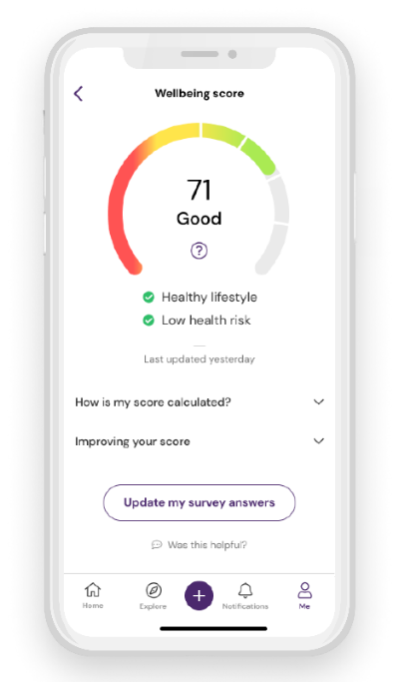
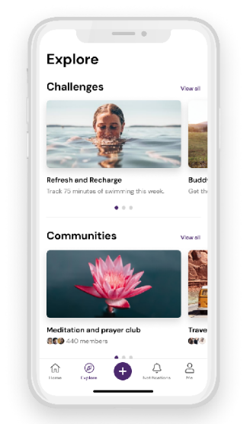
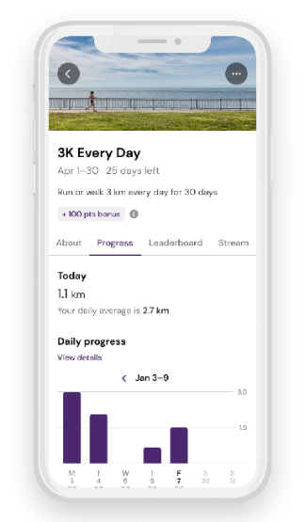
Our healthy vision and strategic focus
est. 2017
Connect team and family members to each other and to resources that support well-being
Becoming our best by enhancing health and well-being for today and tomorrow—at home, at work and in our communities
Implement and maintain a system of support for organizational health and well-being
Assess then improve / optimize team member and family member well-being

Slide 130


Well-being by design
organizational infrastructure and awareness
Outcome analyses
Mental health commitment
⭑
Mental health training
Technology
Tools
Cultural practices & norms
Champion network
Team member involvement
Targeted segmentation
⭑
Flexible, accessible & inclusive resources to support 5 dimensions
⭑
Work and social spaces that promote well-being
Leadership
commitment
⭑
Always on communication
⭑
Policies
⭑
Processes
Data analyses
(review: always on, quarterly, annually)
Network of influencers
Reporting to leaders
Documented strategy (reviews: always on, 1-year, 3-year)
Cross-
functional collaboration
Brand
Data
Scans
Training

Slide 131





Well-being is personal
Physical
Psychological
Social
Environmental
Financial
move | nourish | rest
think | feel | cope
connect | engage | support
arrange | sustain | grow
earn | save | prosper
Unwell
Struggling
Well

Slide 132

Our mental health journey
As part of our overall well-being strategy, we implemented a comprehensive mental health strategy that aligns with the world-class CSA National Standard on Psychological Health and Safety
Why are we on this path?
It’s the right thing to do, but it’s also our duty to avoid reasonably foreseeable harm
To use the Standard’s guidelines, tools and resources to promote mental health, prevent psychological harm and foster human sustainability
To ensure our leaders and team members can confidently support a psychologically safe workplace
To be revered as the healthiest organization with the most admired culture—the best place to work, contribute and flourish as a team
To reduce our people, legal and financial risks associated with poor organizational structure, decision-making, and employee support

Slide 133

Our TELUS Mental Health Commitment
Signed by the entire Executive Leadership Team (ELT), the MH Commitment reinforces the role we all play in promoting healthy practices, examining and addressing workplace factors that may negatively affect mental health, and learning how to offer support to our colleagues who may be in need of our assistance.
At TELUS, we’re all together committed to:
Going above and beyond to make well-being a priority, and that we value total health and well-being
Formalizing our approach to creating a psychologically safe work environment
Reducing stigma and encourage open and honest conversations
Creating a culture of support (we are in this together)
go/mhcommitment
Our new Commitment furthers our work to align with The National Standard of Canada for Psychological Health and Safety in the Workplace

Slide 134

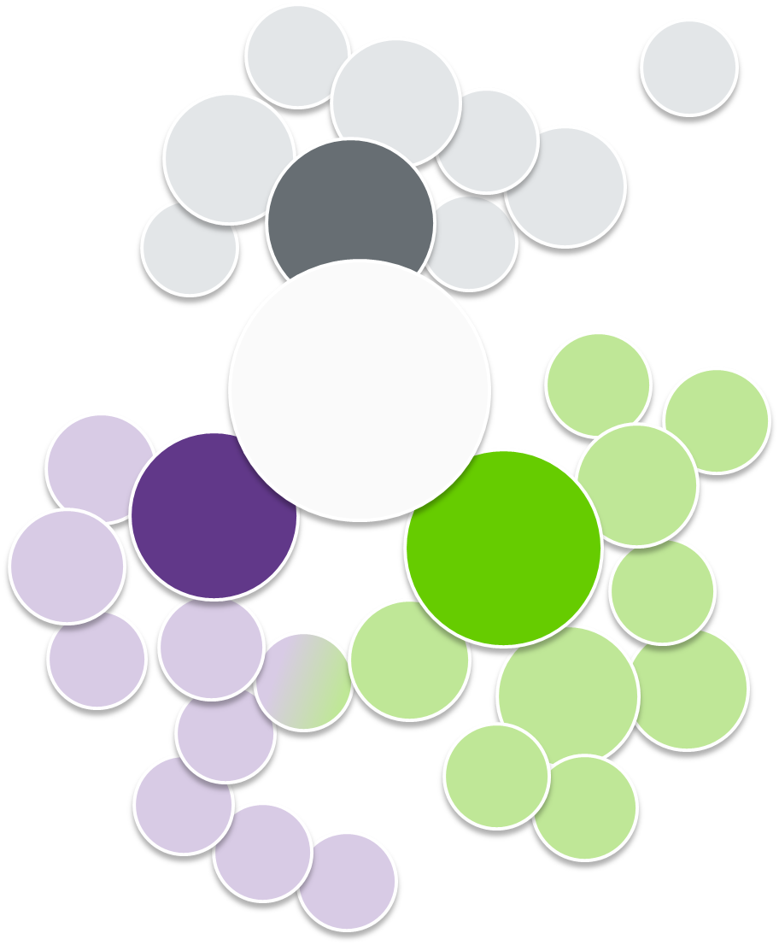
Integration
Giving
Vendors
Real Estate
Our approach
Resource Groups
Finance
TELUS Health
Collaboration: Engage with teams cross-functionally, in P&C and across TELUS, both proactively and to resolve existing issues
Embedded messaging: Help integrate the spirit of well-being into leader messages, performance goals, relevant policies, the TELUS values attributes and behaviours, etc.
Influence culture and plans: Broadly support plan, program, and policy development to magnify well-being outcomes
Sustainable network: Train leaders and team members alike as a network to proactively support well-being for themselves and others
Harmonized data: Integrate disparate data sets and form more robust insights to inform planning and evaluate outcomes
Cross-functional perspectives: Oversee the Well-being & Mental Health Advisory Group, which has TELUS-wide representation
TELUS
Board
Comms
Well-being & Health Services
Labour Relations
Analytics
Comms primes
Learning & Development
Business Units
People & Culture
Well-being primes
Health & Safety
H&S primes
ELT
Talent
Business Partners
Total Rewards
Respectful Workplace
SVPs & VPs
Bravo
Pulse- check
Directors
People Managers
Team Members

Slide 135
Health Services: Philosophy
Champion or supporter (noun)
Recommend or advise (verb)
Linked to the continuum of well-being
Covers all absence types and associated benefits
Advocate for team members who are struggling or unwell, by supporting recovery, promoting holistic well-being and the positives of work.
Navigation of process
Assisting to resolve barriers
Offering of supportive interventions across 5 dimensions
Connection to the workplace
Promoting early and safe RTW
Working towards alignment to the CSA Work Disability Management System Standard (2024)

Slide 136
By understanding the dynamic needs of team members – and by providing them with resources, tools and infrastructure to support them – we can create the right circumstances to help keep them, and our organization, healthy and productive.

Slide 138



Symposium Closing Reflections and Remarks
Wendy Cukier, Director, Diversity Institute, Toronto Metropolitan University; IDEA Advisory Committee Member
Peter Field, Diversity and Inclusion Consultant
Emile Tompa, Executive Director, IDEA; Department of Economics, McMaster
Rebecca Gewurtz, Director, IDEA; School of Rehabilitation Science, McMaster

Slide 139
Funding Acknowledgement
Inclusive Design for Employment Access (IDEA) is supported by generous funding from the Government of Canada’s New Frontiers in Research Fund (NFRF).
Le Vision Radicale Pour L’Accès Inclusif à l’Emploi (VRAIE) est financé par le fonds Nouvelles frontières en recherche du gouvernement du Canada.

